Slide 1

Introduction to Signal Integrity

Slide 2
Module 5
IBIS-AMI Modeling
Channel Operating Margin (COM)
Effective Return Loss (ERL)

Slide 3




Brief SERDES Simulation Tools History
Spice (1971)
Includes non-linear effects and interconnect filtering, undershoots, overshoots, ringing, delays, etc.
Expensive to simulate large number of bits
NRZ DR ~ 50Mbps
IBIS (1993)
IBIS-AMI (2008)
For channel validation
Joint Rx + Tx settings optimization
Simple models in computation core
NRZ DR ~ 60Gbps
COM (2014)
JCOM (2018)
Transient-based flow
Device models separate from computation core, allows more robust IP protection
Can simulate large number of bits fast
NRZ DR ~ 6Gbps
Separates models form computation core
Well-defined core ↔ model communication
Enables more sophisticated models
Allows for efficient computation of link FOM
Tx + Rx filters, but no joint settings optimization without backchannel
NRZ DR ~ 40Gbps

Slide 4
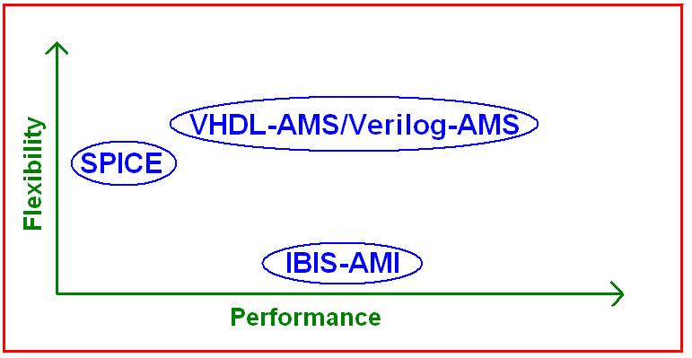
I/O Modeling
SPICE
  Models buffers on silicon level
      i.e. transistor geometries
  Contains IP
  Allows for great flexibility
  Hours to simulate 100s of bits
IBIS
  Originally started in early 90s to overcome above issues
      Used for modeling more basic I/Os
  In 2004 IBIS version 4.1 added support for multiple languages to allow for SERDES modeling
      SPICE
      VHDL-AMS/Verilog-AMS
        Flexibility of SPICE with greater performance
  IBIS-AMI was created as another option for SERDES

Slide 5
The Problem With Spice
Too slow
  Running an 8th order PRBS can take hours
  Validating a trillion bits (i.e. a BER of 10⁻¹²), a 40th order PRBS, would take over 500,000 years
Can be overcome by
  Using different I/O modeling standards
  Using different simulation methodology
  Or a combination of both

Slide 6
The Progression to IBIS-AMI
The IBIS specification was invented because
  Behavioral models simulated much faster than transistor level SPICE models
  Models were portable among different EDA tools
As serial channels became mainstream
  New statistical and signal processing techniques were invented to cover millions of bits worth of simulations
  The need to standardize these techniques became necessary
IBIS-AMI specification was developed
  Algorithmic models are extremely fast
  AMI standard compliant models are portable between different EDA tools
  AMI models from different IC vendors work (or at least are supposed to work) together

Slide 7
IBIS-AMI Modeling

Slide 8

What is IBIS-AMI?
AMI = Algorithmic Modeling Interface
It was first introduced in IBIS version 5.0 (August 2008)
  Section 6c and Section 10 of the IBIS specification
Algorithmic means that instead of circuit descriptions, AMI models are made up of signal processing algorithms
Interface means that the specification describes the interface through which the parameters and waveforms can be passed in and out of the AMI models (as opposed to the content of the model)
AMI models are compiled binary executables
  Source code in MATLAB, C or any suitable language
  Separate executable must be compiled for each OS

Slide 9
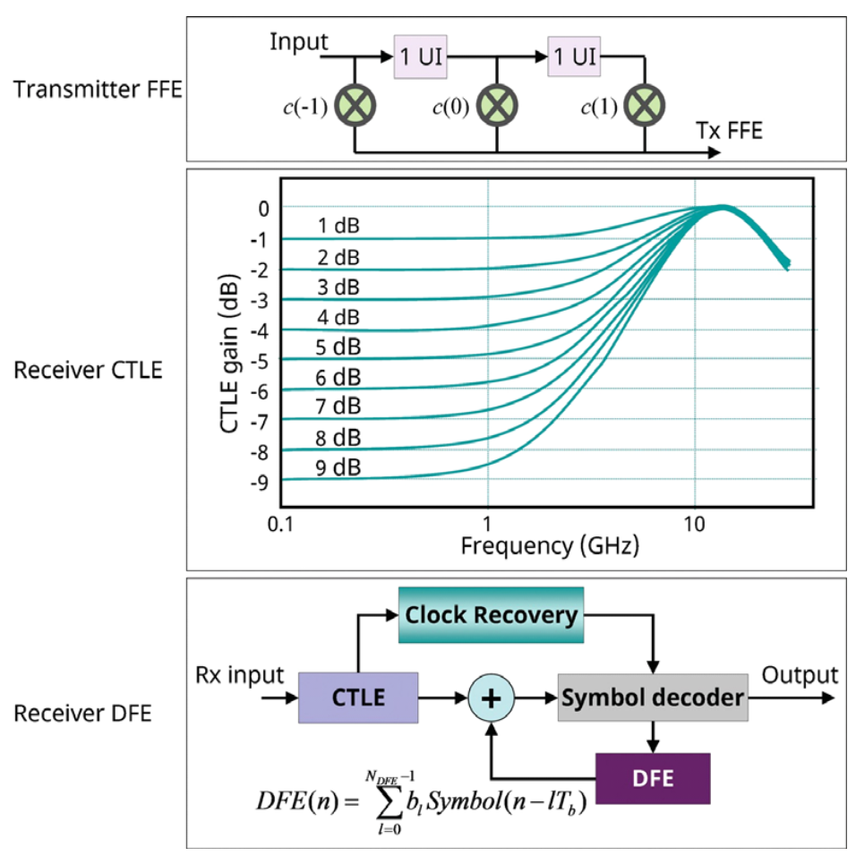
Primary Uses of IBIS-AMI
Think “digital signal processing” (DSP)
  Filters, equalizers (FIR, IIR, DFE)…
  Clock recovery circuits (CDR)…
  Everything else you can invent…
  True, these could all be modeled with full transistor level SPICE models (as they are implemented on silicon), but solving the circuit equations for thousands of transistors is computationally very demanding and takes a very long time to simulate (can’t get your job done)
  This gave birth to the various statistical and signal processing analysis techniques, and IBIS-AMI

Slide 10
Building Blocks of an IBIS-AMI Simulation
Normal analog
IBIS
models
Tx DLL
Analog Channel Characterization
Rx DLL
Tx
EQ
Tx
analog
Pkg + PCB + Connector + PCB + Pkg
Rx
analog
Rx
CDR, EQ
Included in the Channel Impulse Response
IBIS-AMI
IBIS-AMI

Slide 11
Transmitter Models
Model silicon very well
Capabilities and controls straight forward
    Output Voltage
    Pre-cursor settings
    Post-cursor settings
Output jitter often omitted from the model
  Device manufacturers expect jitter to be added in the simulation tool
Transmitter PLL usually not modeled
Power supply noise not modeled
Reference clock not modeled
Correlation of the transmitter output is relatively straight forward

Slide 12
Receiver Models
Can be very complex
Can have complex equalizers at the input
    AGC, CTLE and DFE can have many parameters
    The equalizers may have reserved parameters which are undocumented
Measurement point is usually after the equalizer
    Eyes inside of the equalizer have proprietary pass/fail
    Users may need to obtain pass/fail mask for device from the manufacturer or extrapolate the information
    Need to select the pattern sequence correctly when using auto-adaptation
Correlating the results is more difficult

Slide 13
High Level AMI “Data flow”
“Channel Characterization”
Traditional time domain simulation of the channel that produces a channel response as seen at the receiver (Rx)
“Signal Processing”
The channel response is processed by the Tx and Rx AMI dll-s
“Results from Signal Processing”
V(t) waveform & series of “clock ticks”
“Post processing the AMI results”
Eye Density and Statistical output plots, such as Bit Error Rate (BER) curves and surfaces

Slide 14
Simulation Process with IBIS-AMI (step 1)
The fundamental input to an AMI simulation is the Impulse Response (IR) of the channel
The IR is generated by a “Channel Characterization” simulation
  One method for generating an IR is to take the derivative of a normal time domain step response simulation waveform
The channel characterization simulation must include:
  Analog interface of the driver (Tx)
  Driver package model
  Printed circuit board (PCB) traces (transmission lines)
  Via models, connectors, cables, etc… if any
  Receiver package model
  Analog interface of the receiver (Rx)
The analog buffer models are very important in this to capture the correct reflections at the ends of the channel

Slide 15
Simulation Process with IBIS-AMI (step 2)
The AMI models then modify the IR of the channel with their signal processing algorithms
There are two main types of AMI simulations
  Statistical (using the AMI_Init functions only)
  Time domain or bit-by-bit (using the AMI_GetWave functions)
In statistical analysis the IR of the channel is modified in the AMI models by applying the various equalizer and filter algorithms
  Only LTI filter algorithms can be implemented (FIR, etc…)
In time domain analysis a (long) bit pattern is passed into the AMI models along with the IR of the channel
  This method can also simulate non-LTI blocks (DFE, etc…)
Reserved Parameters:
  Init_Returns_Impulse – indicates that the model AMI_Init() function can return a filtered response
  GetWave_Exists – indicates that the model supports the AMI_GetWave()function. If GetWave_Exists is false, then the Init_Returns_Impulse must be true.

Slide 16
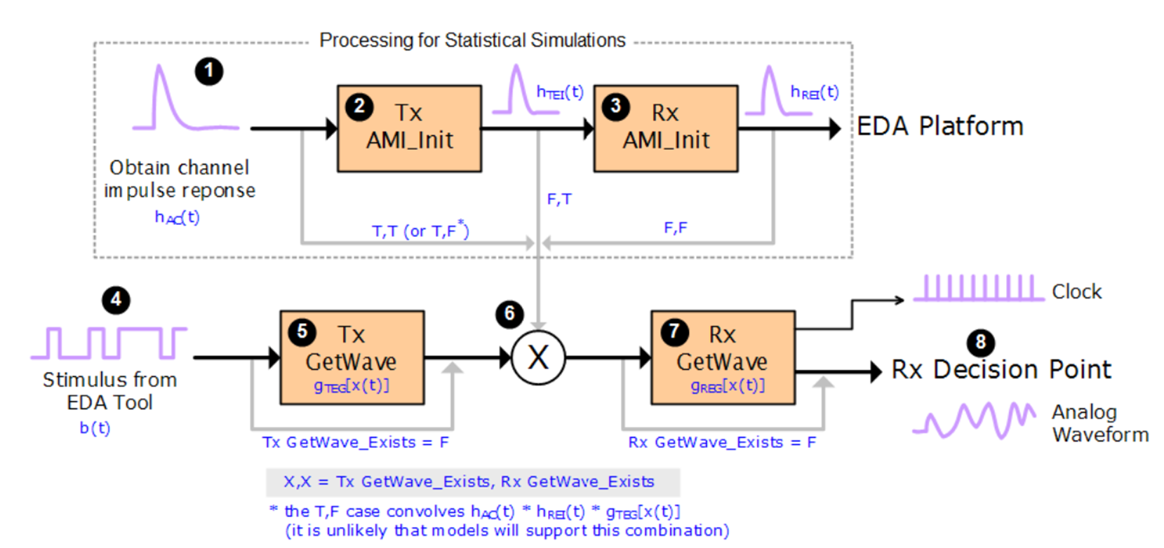
The IBIS-AMI Statistical and Time-domain Reference Flow

Slide 17
Two Kinds of AMI Models + a “Hybrid”
Model builders must provide either an AMI-GetWave() function or an impulse response inside AMI_Init().
Optionally, they may provide both, but not an empty model otherwise this will be a do-nothing situation = passthrough model.
Two Kinds of Tx/Rx Plus a “Dual” or “Hybrid” model |  | Model’s Init_Returns_Impulse flag is:
 |  | False (“Can’t be modeled as LTI”) | True (“LTI model via impulse response”)
Model’s GetWave_Exists flag is: | False (“Model is pure LTI”) | Empty model: not allowed | Typical case for Tx and simple Rx’s (fixed Eq. and no CDR)
 | True (“NLTV model via waveform modification”) | Typical case for Rx (Adaptive Eq., CDR) | Buyer beware: LTI approximation of NLTV device if used in stat mode

Slide 18
Statistical Mode
Statistical simulations may be performed using the AMI_Init() function alone, that originally was invented to initialize memory, parameters, etc., but later was allowed to have filtering algorithms too.
Whether the Init function does modify the channel IR that is passed into it is indicated by the parameter “Init_Returns_Impulse”. If this is true, it means that the Init function implemented filter algorithms.
If both Tx and Rx have the Init_Returns_Inpulse function set to “true”, when EDA tool runs a statistical simulation, it will execute the two Init functions and plot the output of the Rx Init function (which also includes what the Tx Init did, since they are executed “in series”).
If any of the Init_Returns_Inpulse function set to “false”, the situation gets more complex.
The GetWave functions are not required to exist, but if they do, they are typically used for non LTI filtering (such as DFE).
Since DFE is situated in Rx, most of the time the Rx is the one that require GetWave function.

Slide 19
Statistical Mode
If a model has both AMI-GetWave() and AMI_Init() functions, the EDA tool decides which one to use depending on how the flags of the Init_Returns_Impulse parameters are set as shown in the table below:
If the model has GetWave only, and the Init function doesn’t contain the filtering algorithms, the EDA tool would have to “extract” the filter’s impulse response from the GetWave function and make use of that in the Init flow. Since GetWave may contain non-LTI filters, this may not always be possible, or accurate.
Statistical Mode |  | Tx model’s Init_Returns_Impulse flag is:
 |  | False (“Tx can’t be modeled as nor approximated as LTI”) | True (“Tx can be modeled as LTI using AMI_Init()”)
Rx model’s Init_Returns_Impulse flag is: | False (“Rx cannot be modeled nor approximated as LTI”) | Not recommended. | Not recommended.
 | True (“Rx can be modeled as LTI using AMI_Init()”) | Not recommended. | Case 1

Slide 20
Example Statistical Mode
Case 1

Slide 21
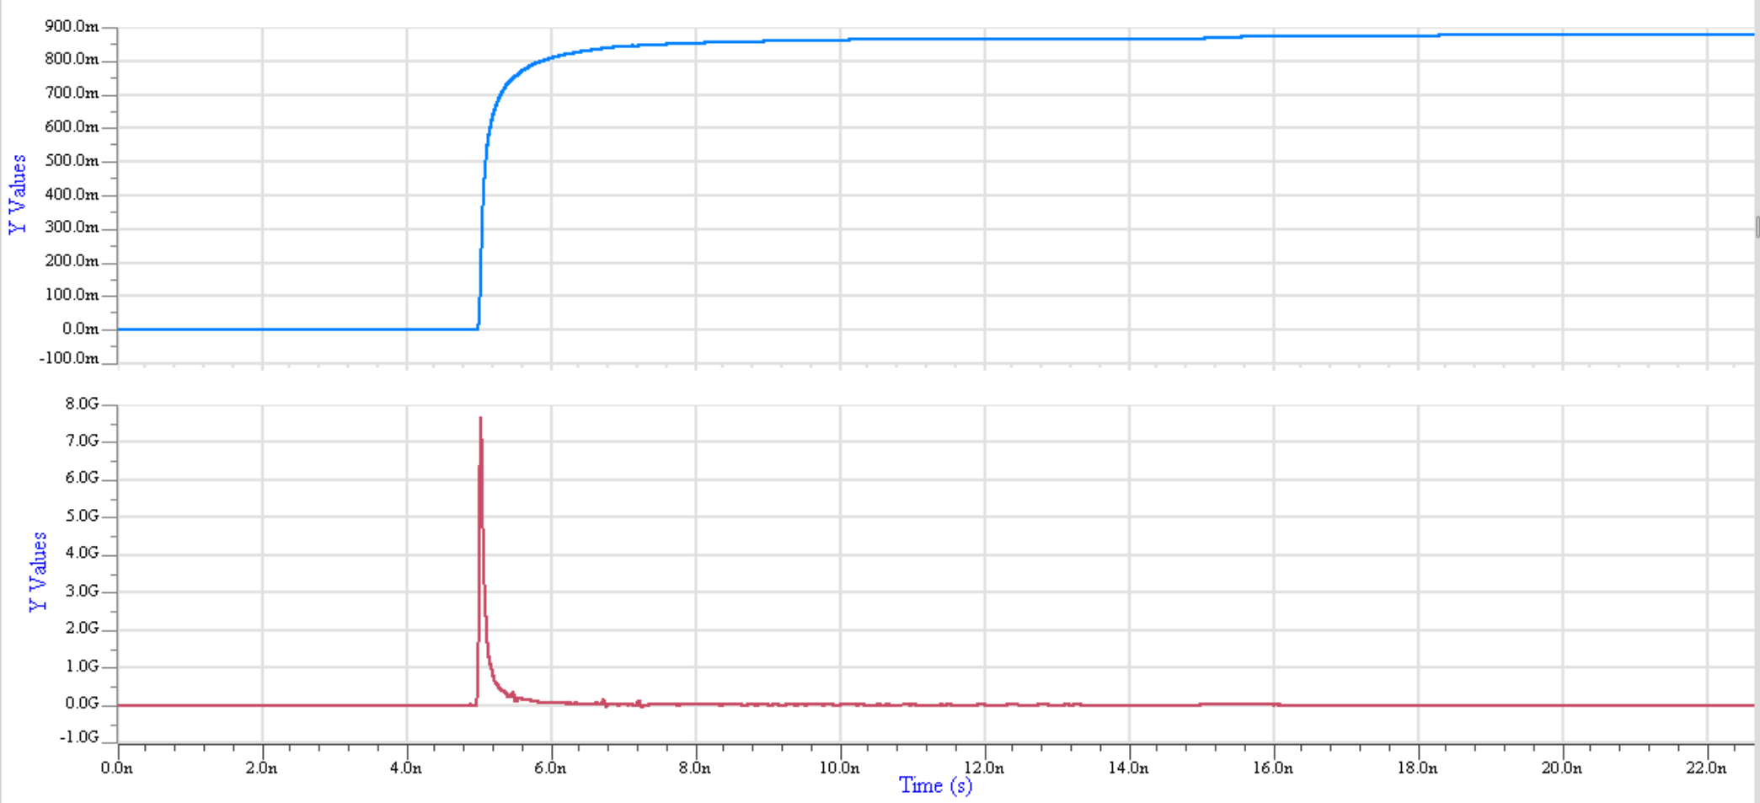
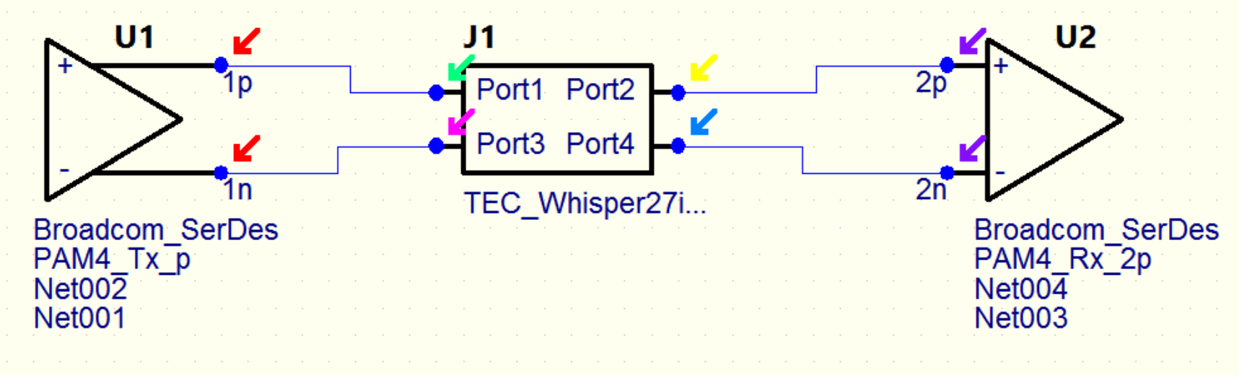
Statistical Simulation Step 1
Step response
(from channel characterization)
1
Analog Channel Impulse response H_{AC}(t)
(the derivative of the step response)

Slide 22
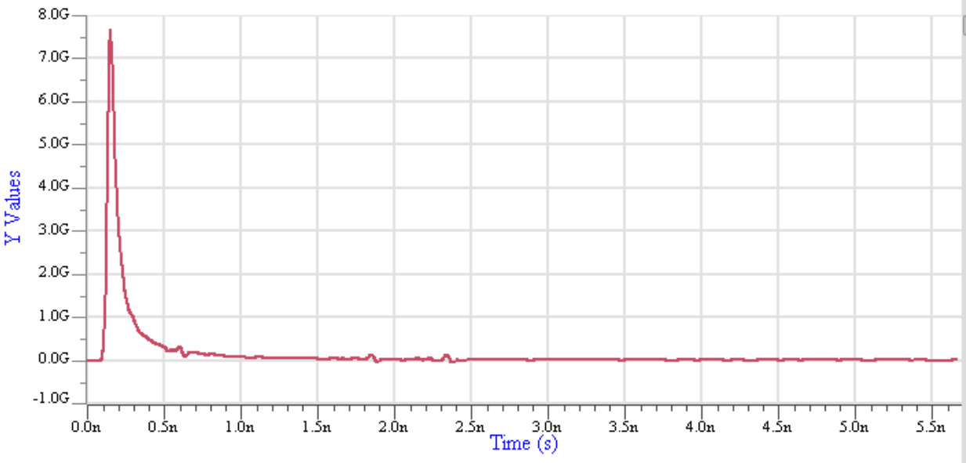
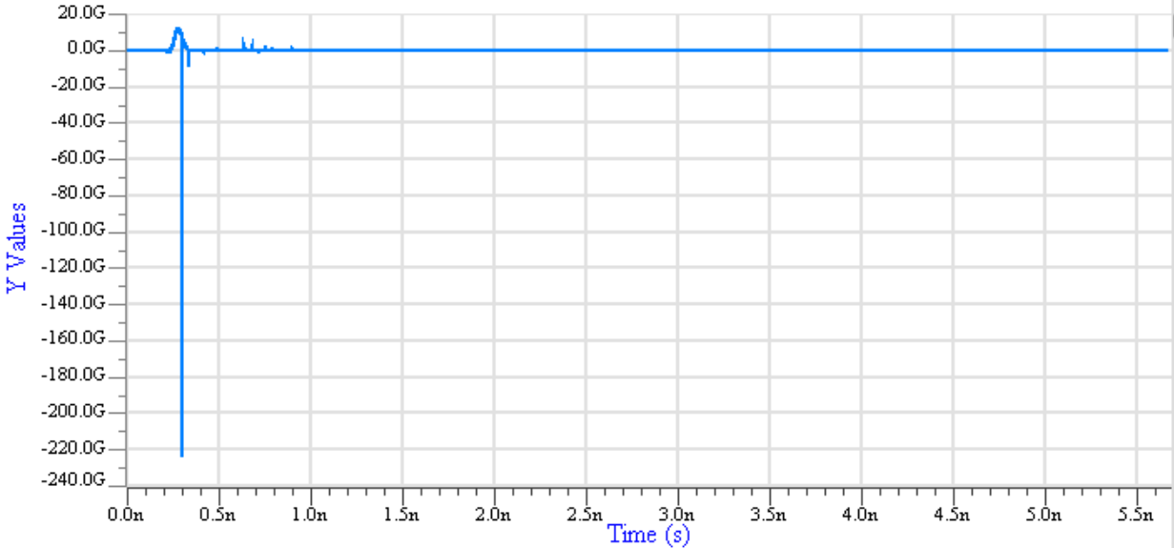
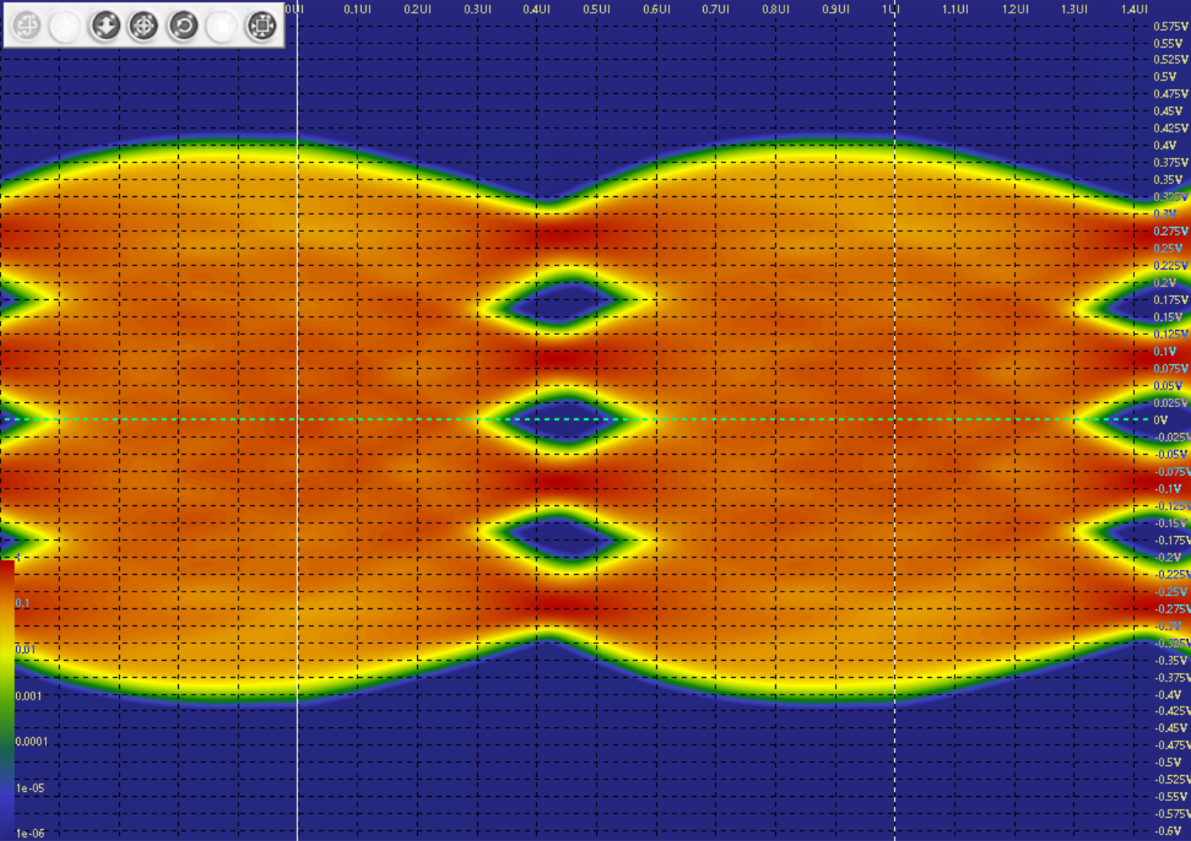
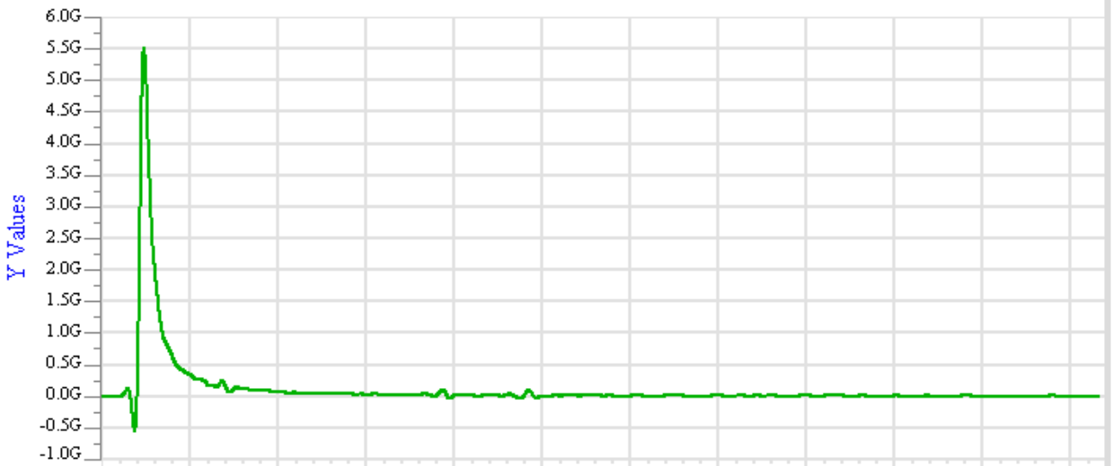
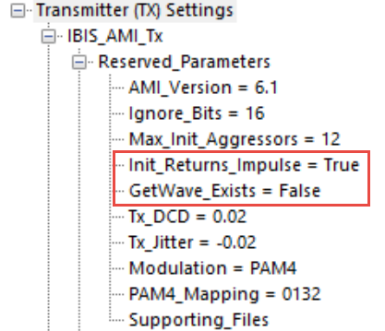
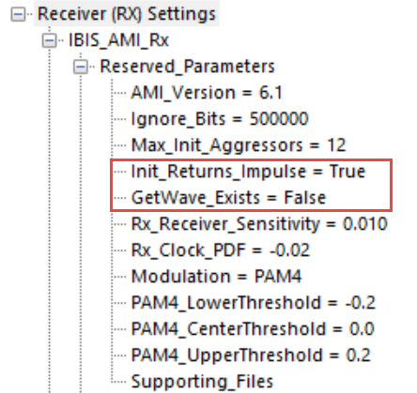
Statistical Simulation Steps 2 and 3
EDA tool processing
H_{AC}(t) *H_{TEI}(t)*H_{REI}(t)
H_{AC}(t)
H_{REI}(t)
2
3
Tx AMI-Init() = True =>
Tx equalization and/or filtering
is applied to H_{AC}(t)
H_{AC}(t) *H_{TEI}(t)
Rx AMI-Init() = True =>
Rx equalization and/or filtering
is applied to H_{AC}(t) * H_{TEI}(t)
H_{TEI}(t)

Slide 23
Time Domain / Bit-by-bit Mode
The following cases are possible:
  Neither model have an AMI_GetWave() function.
  The Tx model does not have an AMI_GetWave() function, but the Rx does.
  Both models have an AMI_GetWave() function.
  The Tx model does have an AMI_GetWave() function, but the Rx doesn’t.
Time Domain /Bit-by-bit Mode |  | Tx model’s GetWave_Exists flag is:
 |  | False (“Tx does not have AMI_GetWave()”) | True (“Tx has AMI_GetWave()”)
Rx model’s GetWave_Exists flag is: | False (“Rx does not have AMI_GetWave()”) | “Case 2” | “Case 5” (Rarely used)
 | True (“Rx has AMI_GetWave()”) | “Case 3” (Most common case) | “Case 4”

Slide 24
Time Domain / Bit-by-bit Mode
  Case 2 - neither model have an AMI_GetWave() function
    This case is similar to statistical mode in that the channel, Tx, and Rx must all be LTI.
    It is slower than the statistical mode especially for the long bit patterns needed for ultralow BER contours, but it does offer more flexibility in that the user can select any bit pattern they choose.
  Case 3 - The Tx model does not have an AMI_GetWave() function, but the Rx does
    This is the most common case in practice. The Tx is often an LTI circuit such as a de-emphasis filter, the channel is LTI, and the Rx is a non-linear time-varying (NLTV) circuit like an adaptive equalizer and/or clock/data recoverer.
    The throughput is thousands of times faster than SPICE, on the order of a million bits per minute, and simulation length of 10⁸ bits are easily achievable.
  Case 4 - Both models have an AMI_GetWave() function
    Both the Tx and Rx can be NLTV and allows Rx to optimize its AMI_GetWave() function for maximum mitigation of the impairments.
  Case 5 - The Tx model does have an AMI_GetWave() function, but the Rx doesn’t
    This is the most complex case and rarely used in practice as it involves counterintuitive deconvolutions of the responses that were convolved in the pre-work.

Slide 25
Example Time Domain /Bit-by-bit Mode
Case 3 - The Tx model does not have an AMI_GetWave() function, but the Rx does

Slide 26
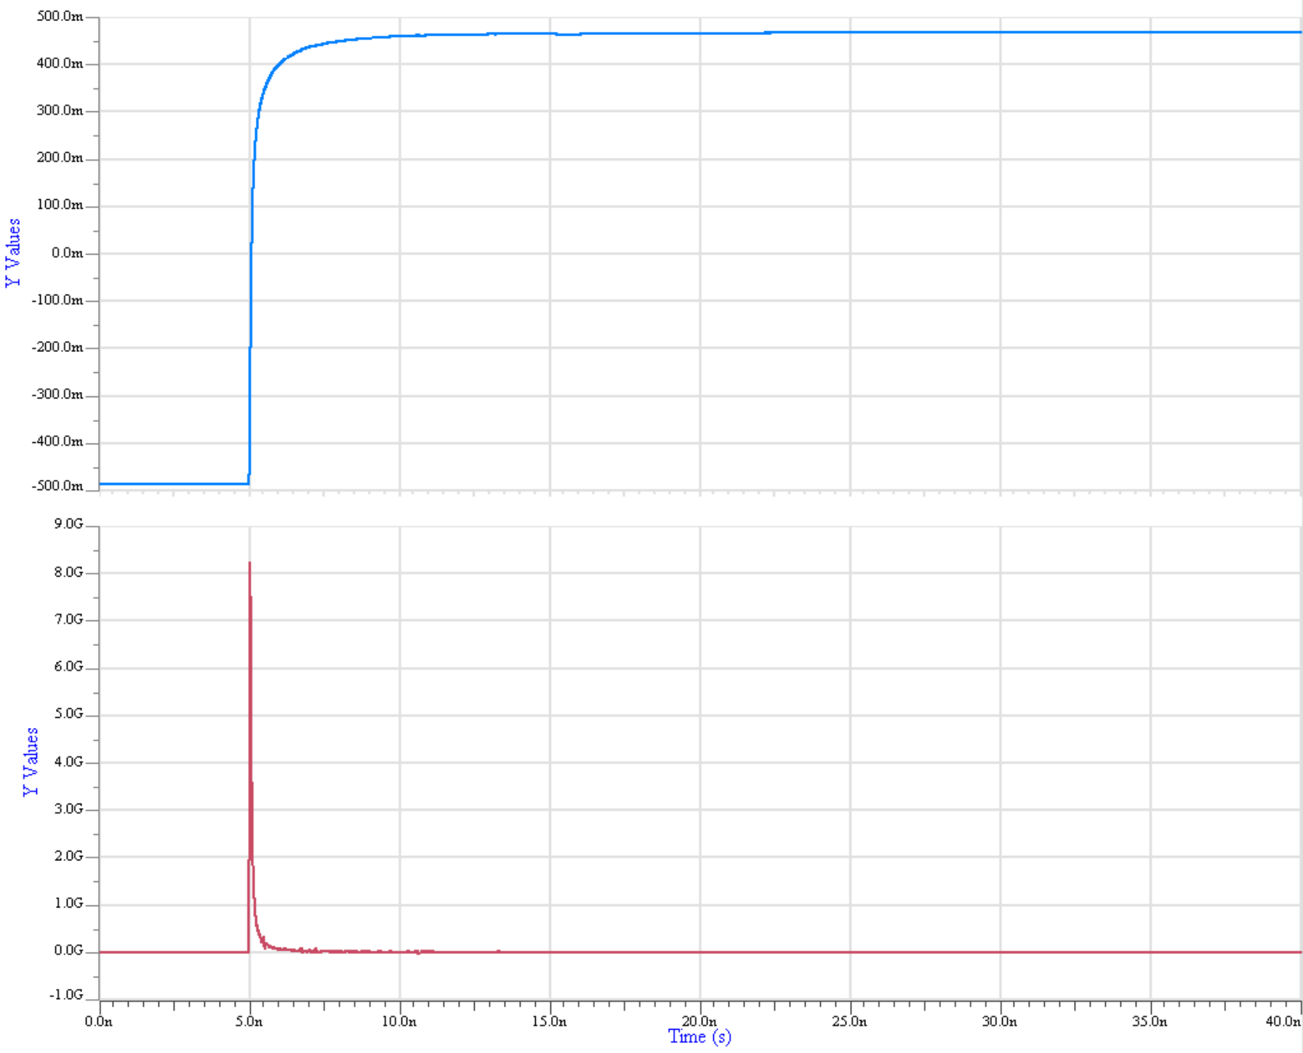
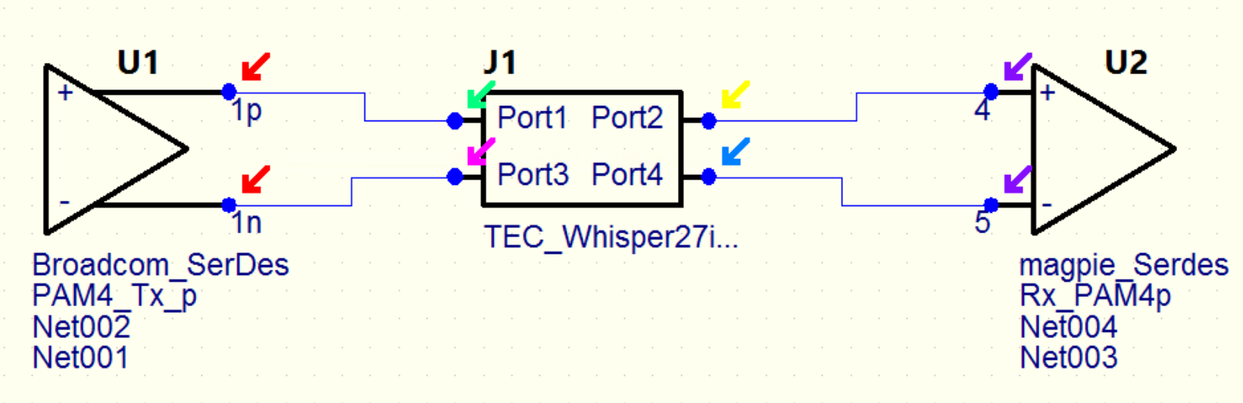
Bit-by-Bit Simulation Step 1
Step response
(from channel characterization)
1
Analog Channel Impulse response H_{AC}(t)
(the derivative of the step response)

Slide 27
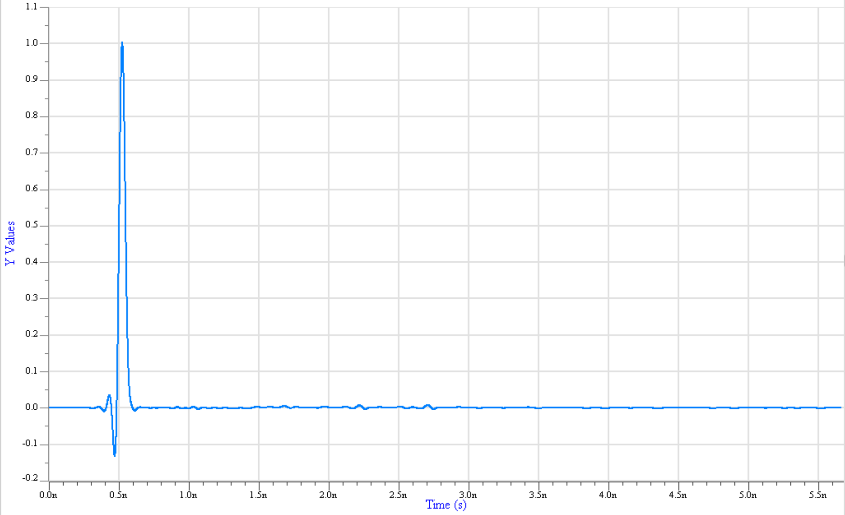
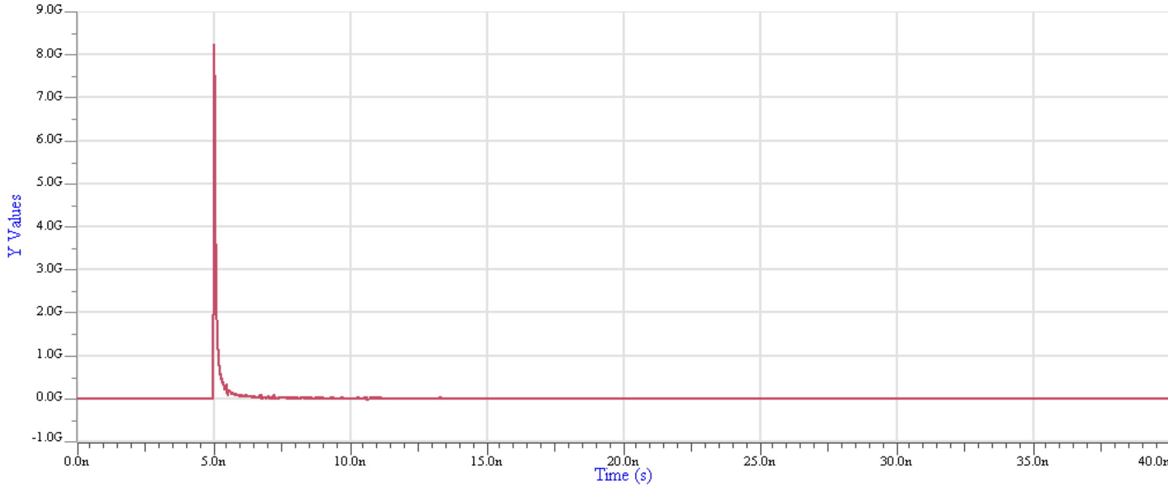
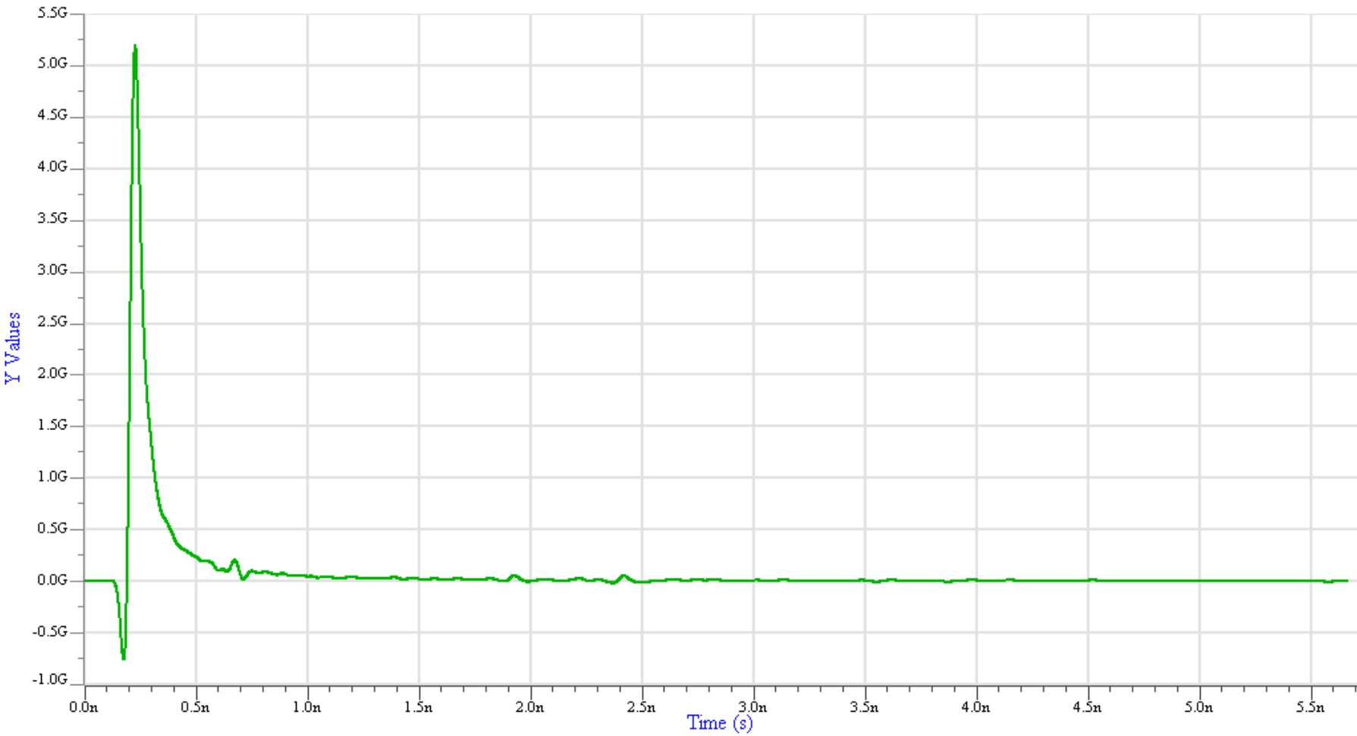
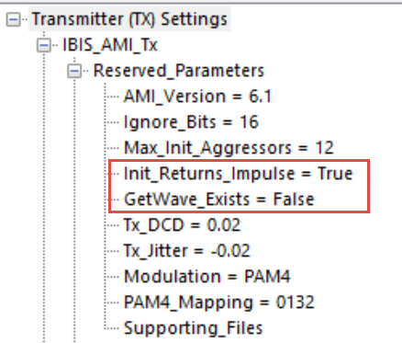
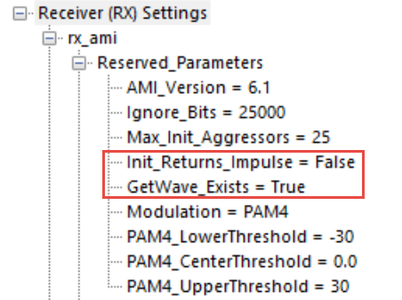
Bit-by-Bit Simulation Steps 2 and 3
H_{REI}(t)
H_{AC}(t)
2
3
Tx AMI-Init() = True
Tx equalization and/or filtering
is applied to H_{AC}(t)
Rx AMI-Init() = False
Apparently some FFE
was applied
H_{TEI}(t) modified by Tx equalization

Slide 28
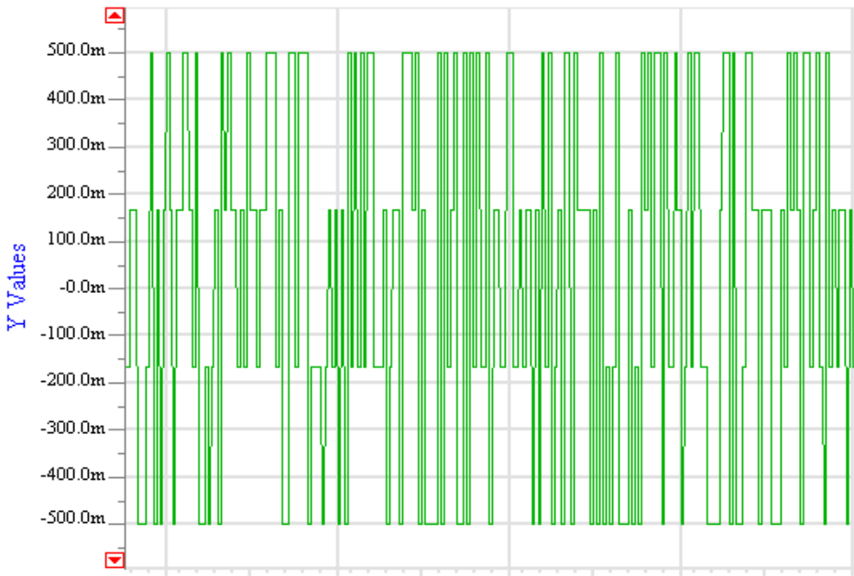
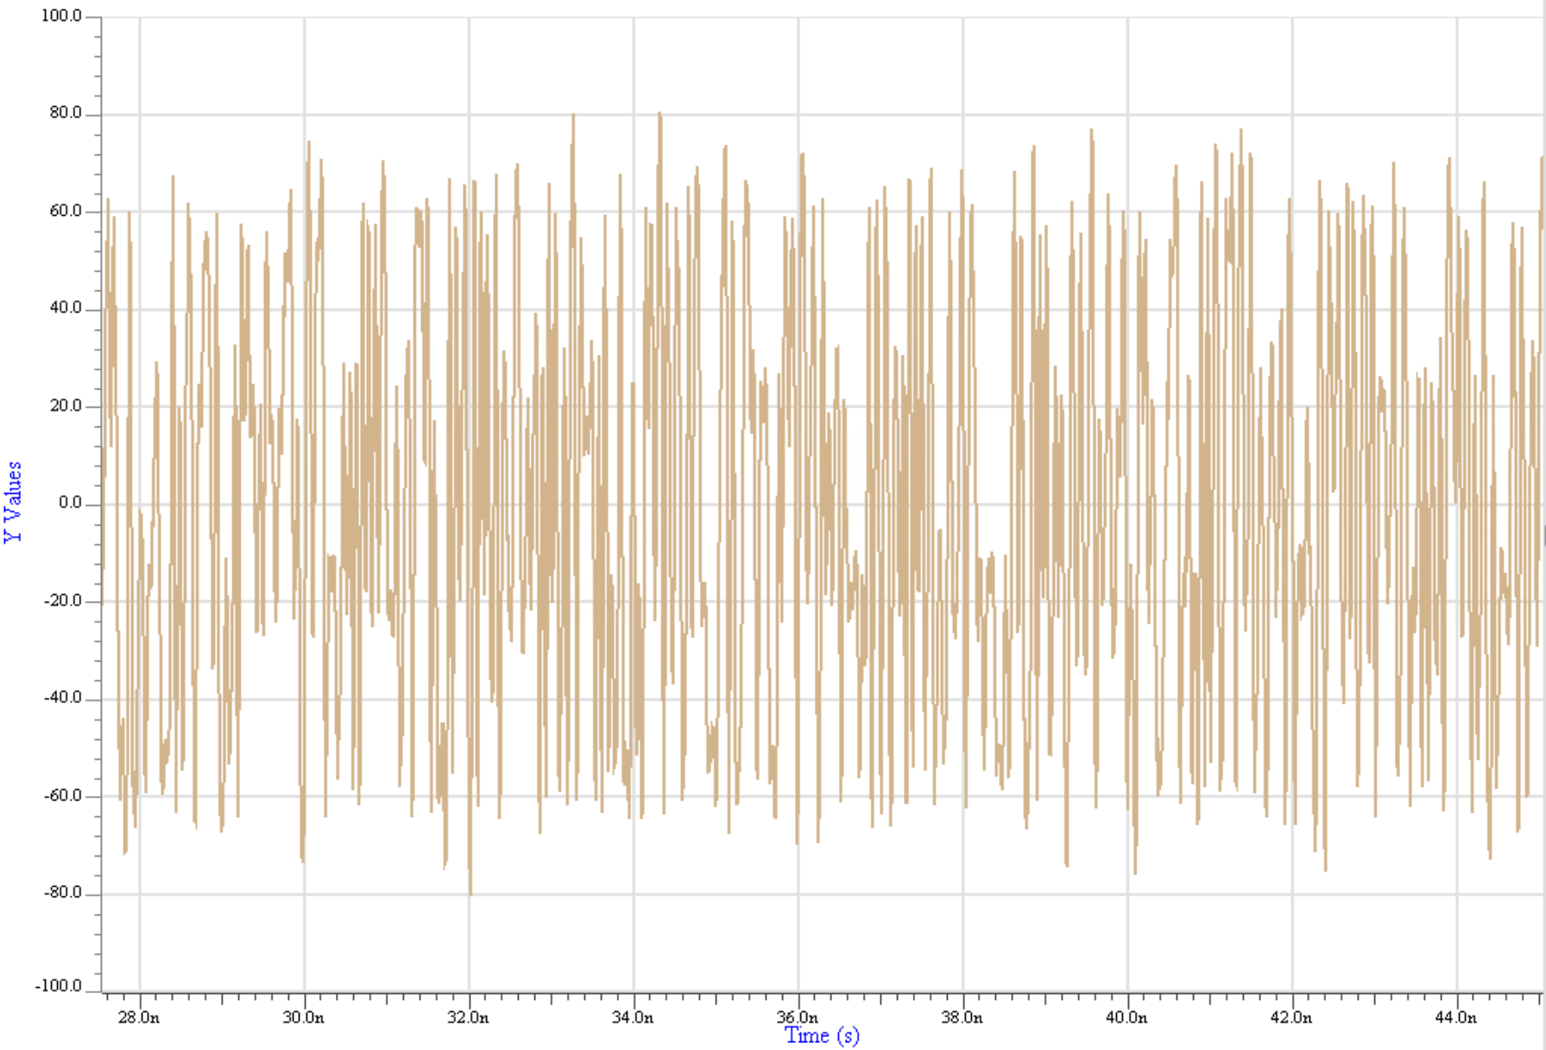
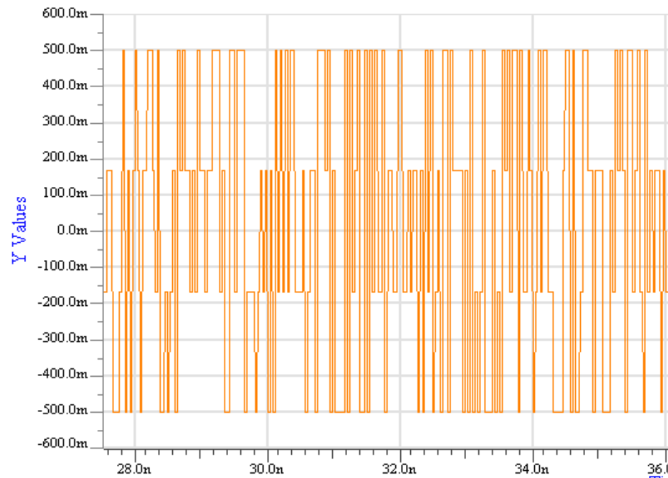
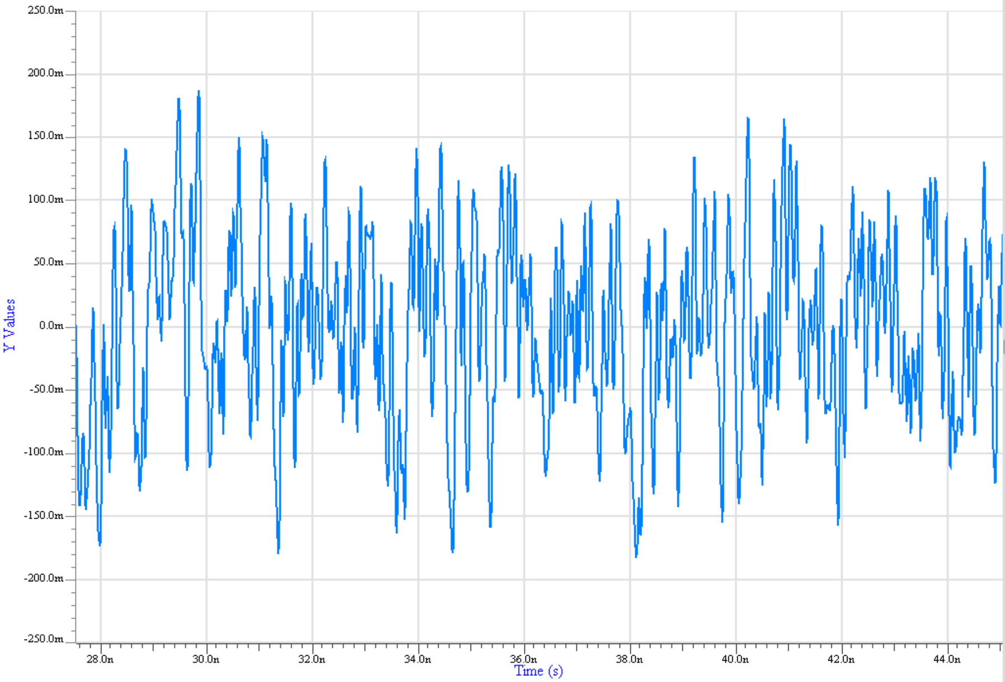
Bit-by-Bit Simulation Steps 4 to 7
Stimulus from the EDA tool
Rx Equalization & Filtering
4
g_{REG}[x(t)]
7
Rx AMI_GetWave() = True =>
Rx equalization and/or filtering
is applied to the Rx AMI_GetWave()
function
Tx AMI_GetWave() = False =>
Tx equalization and/or filtering
is not applied to the Tx AMI_GetWave()
function
Analog waveform sent to EDA tool for processing
5
6
H_{TEI}(t)
H_{TEI}(t) includes
Tx Equalization & Filtering
g_{TEG}[x(t)] same as stimulus
No Tx Equalization & Filtering

Slide 29
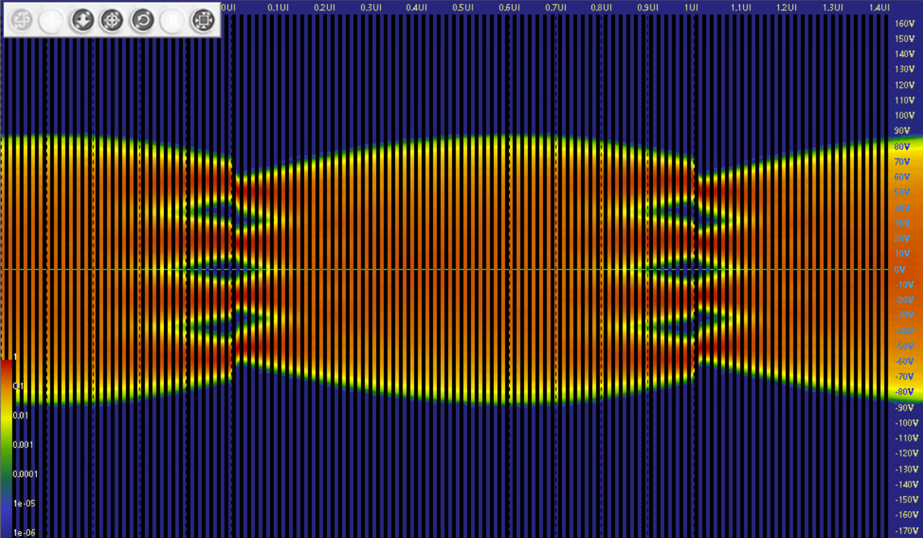

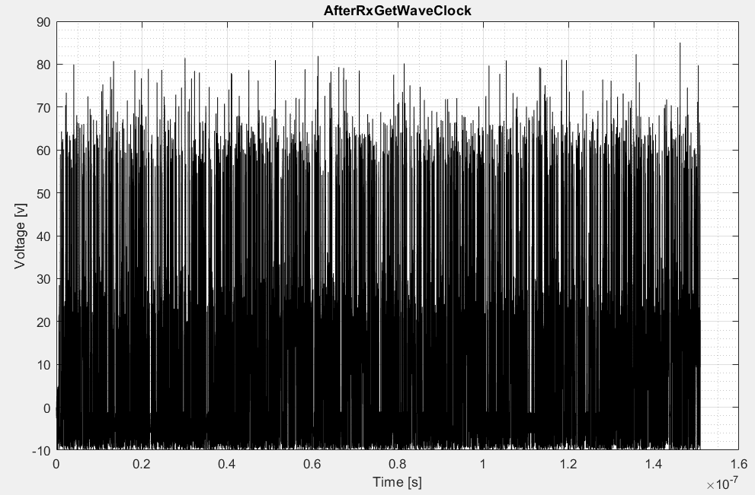
Bit-by-Bit Simulation Step 8
g_{REG}[x(t)]
7
8
g_{REG}[x(t)]*H_{AC}(t) * H_{TEI}(t)
Rx Decision Point
Analog waveform sent to EDA tool for processing
Analog waveform
Clock
7

Slide 30
Example Time Domain /Bit-by-bit Mode
  Case 4 - Both models have an AMI_GetWave() function

Slide 31
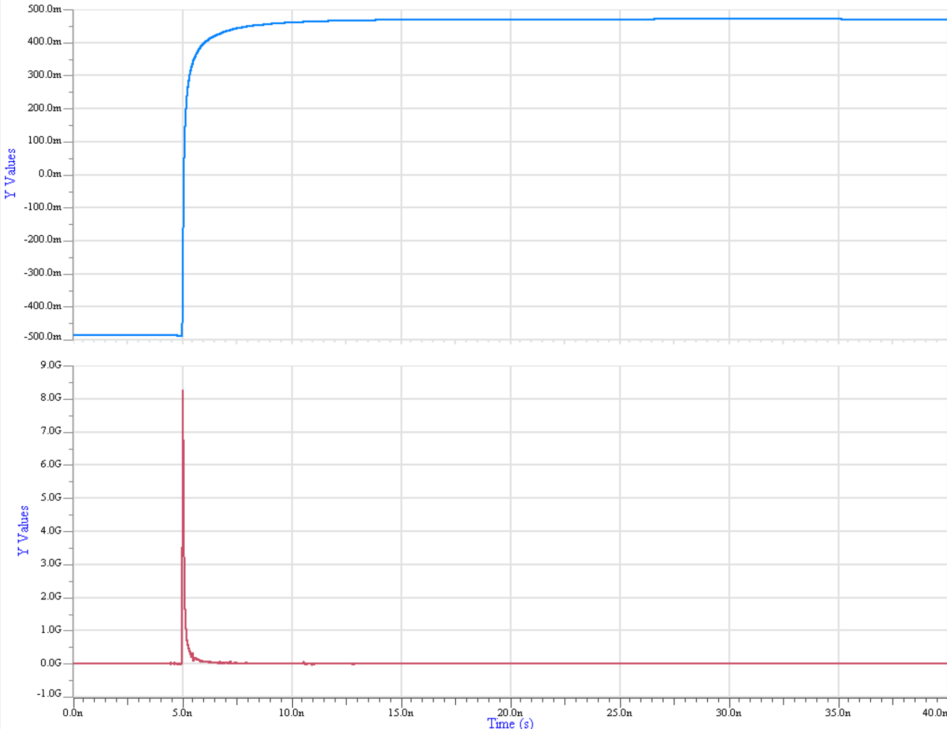
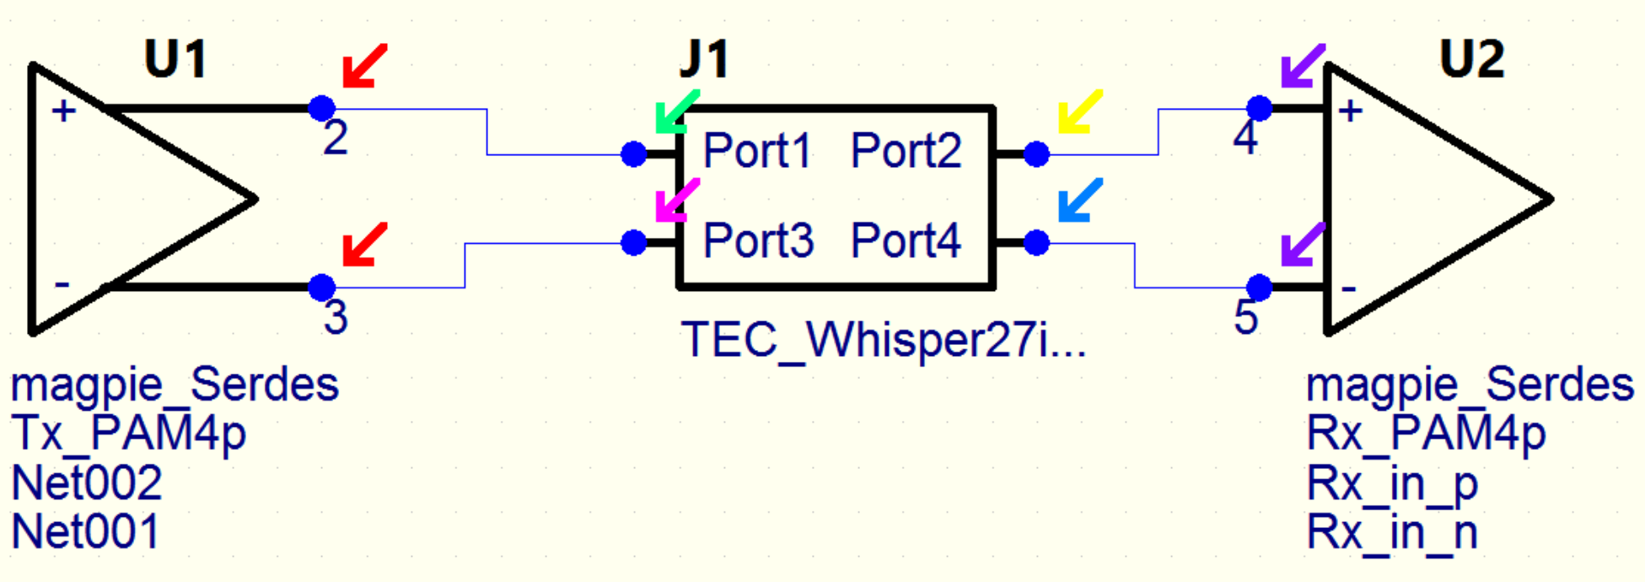
Bit-by-Bit Simulation Step 1
Step response
(from channel characterization)
1
Analog Channel Impulse response H_{AC}(t)
(the derivative of the step response)

Slide 32
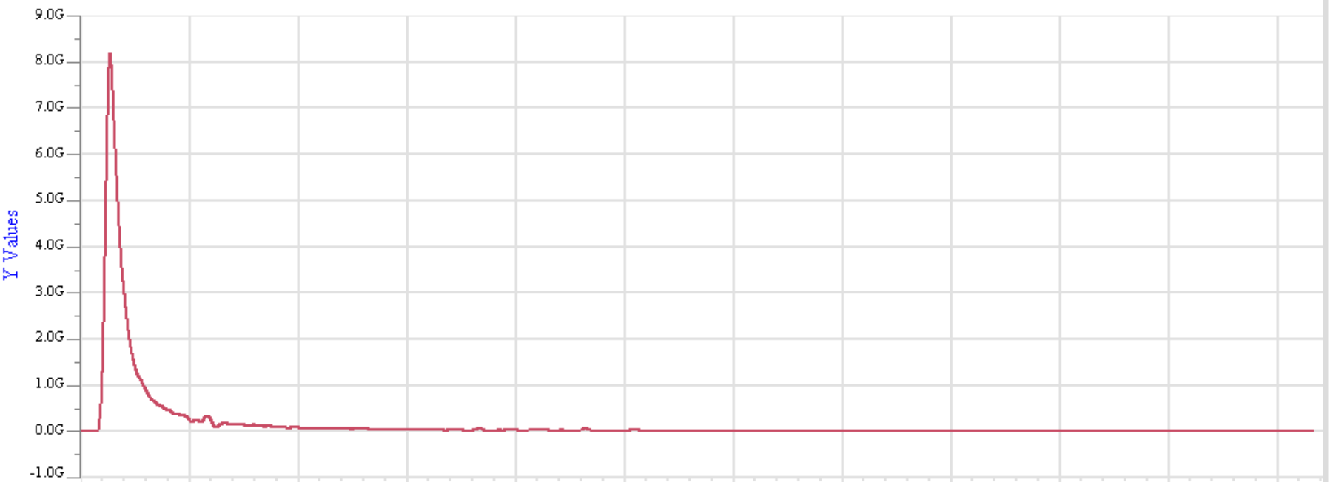
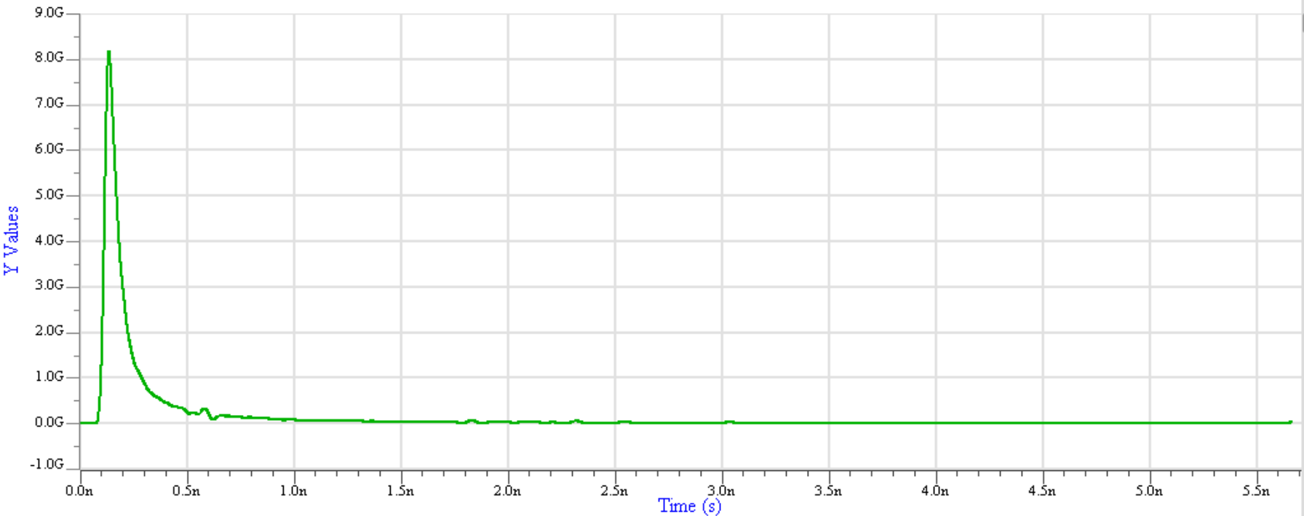
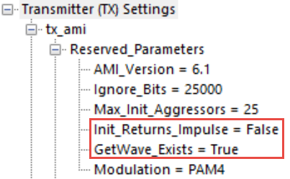
Bit-by-Bit Simulation Steps 2 and 3
H_{REI}(t)
H_{AC}(t)
2
3
Tx AMI-Init() = False
Tx equalization or filtering
is not applied to H_{AC}(t)
Rx AMI-Init() = False
Apparently some FFE
was applied
H_{TEI}(t) identical with H_{AC}(t)

Slide 33
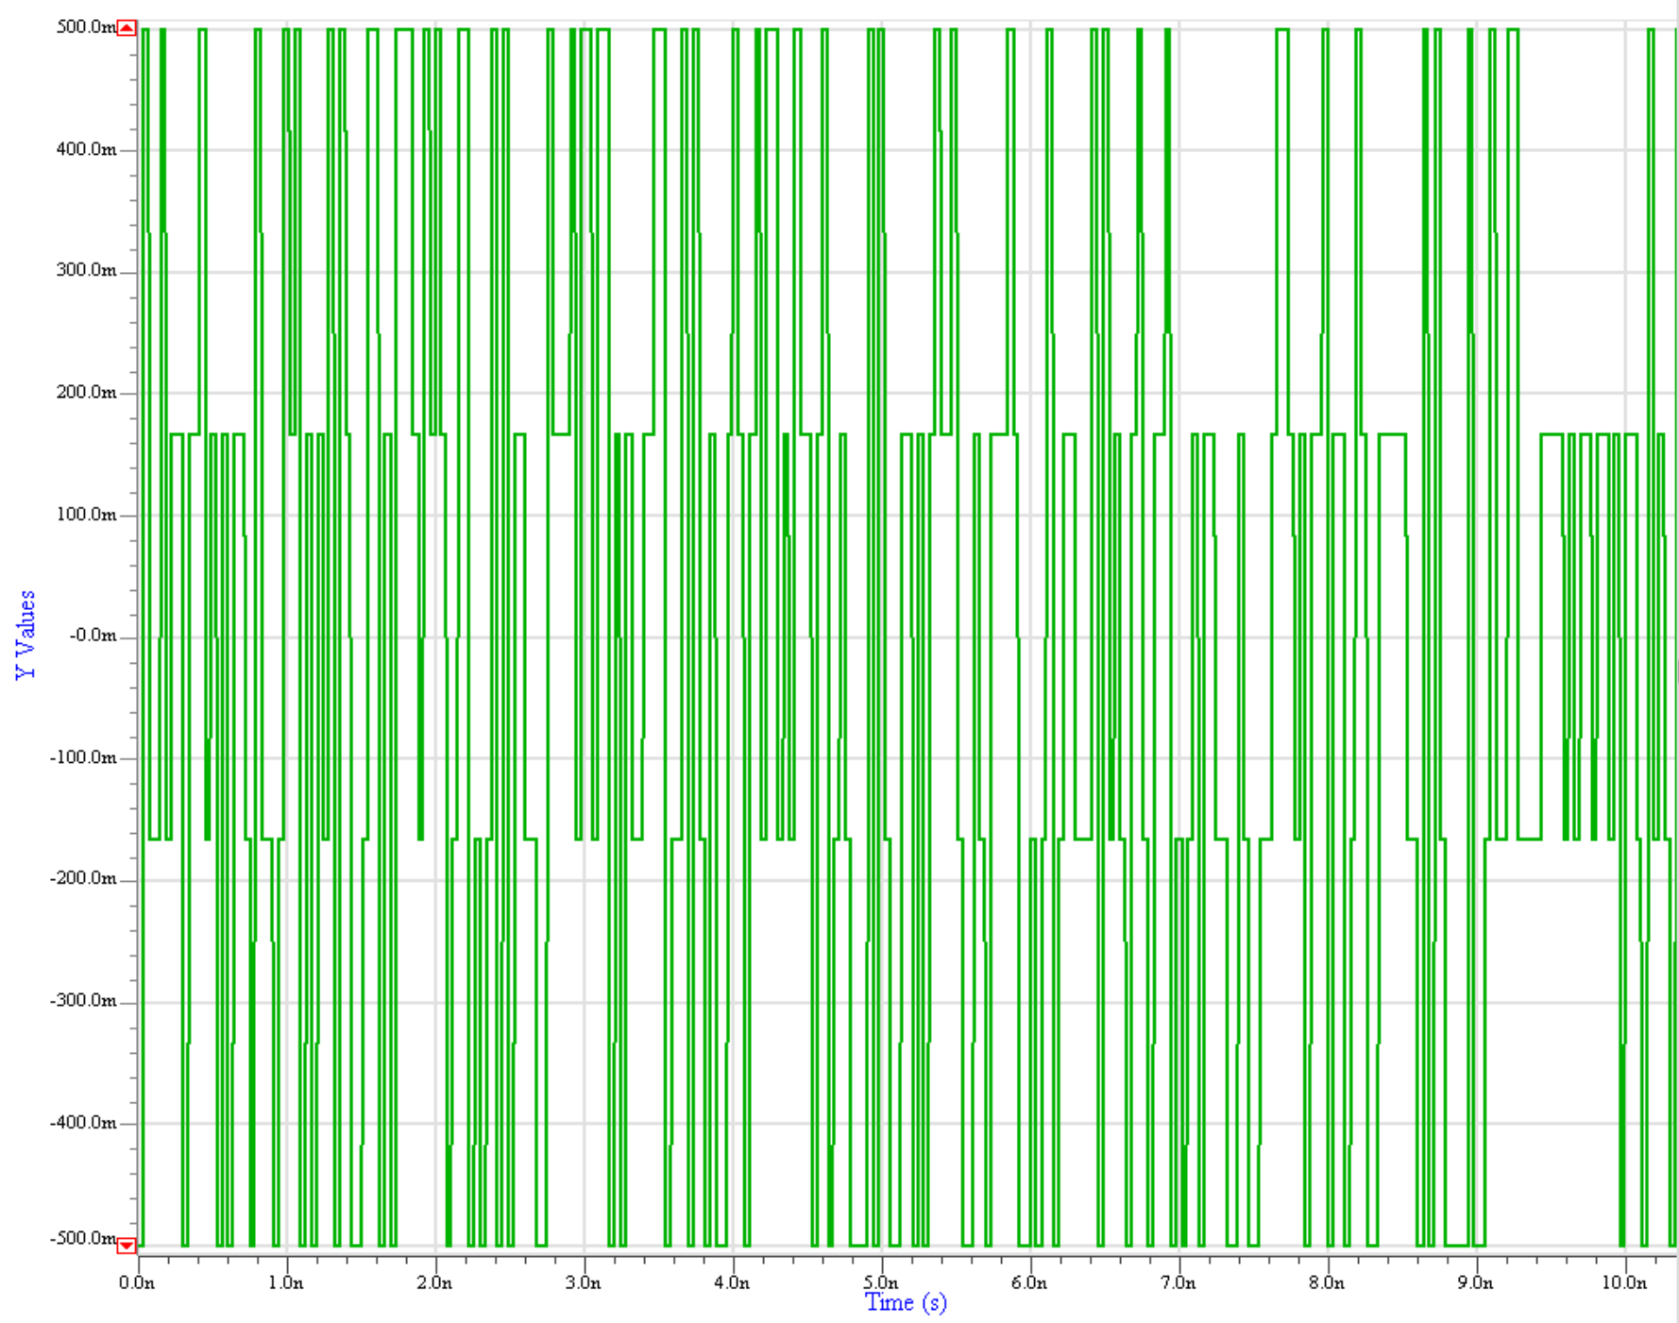
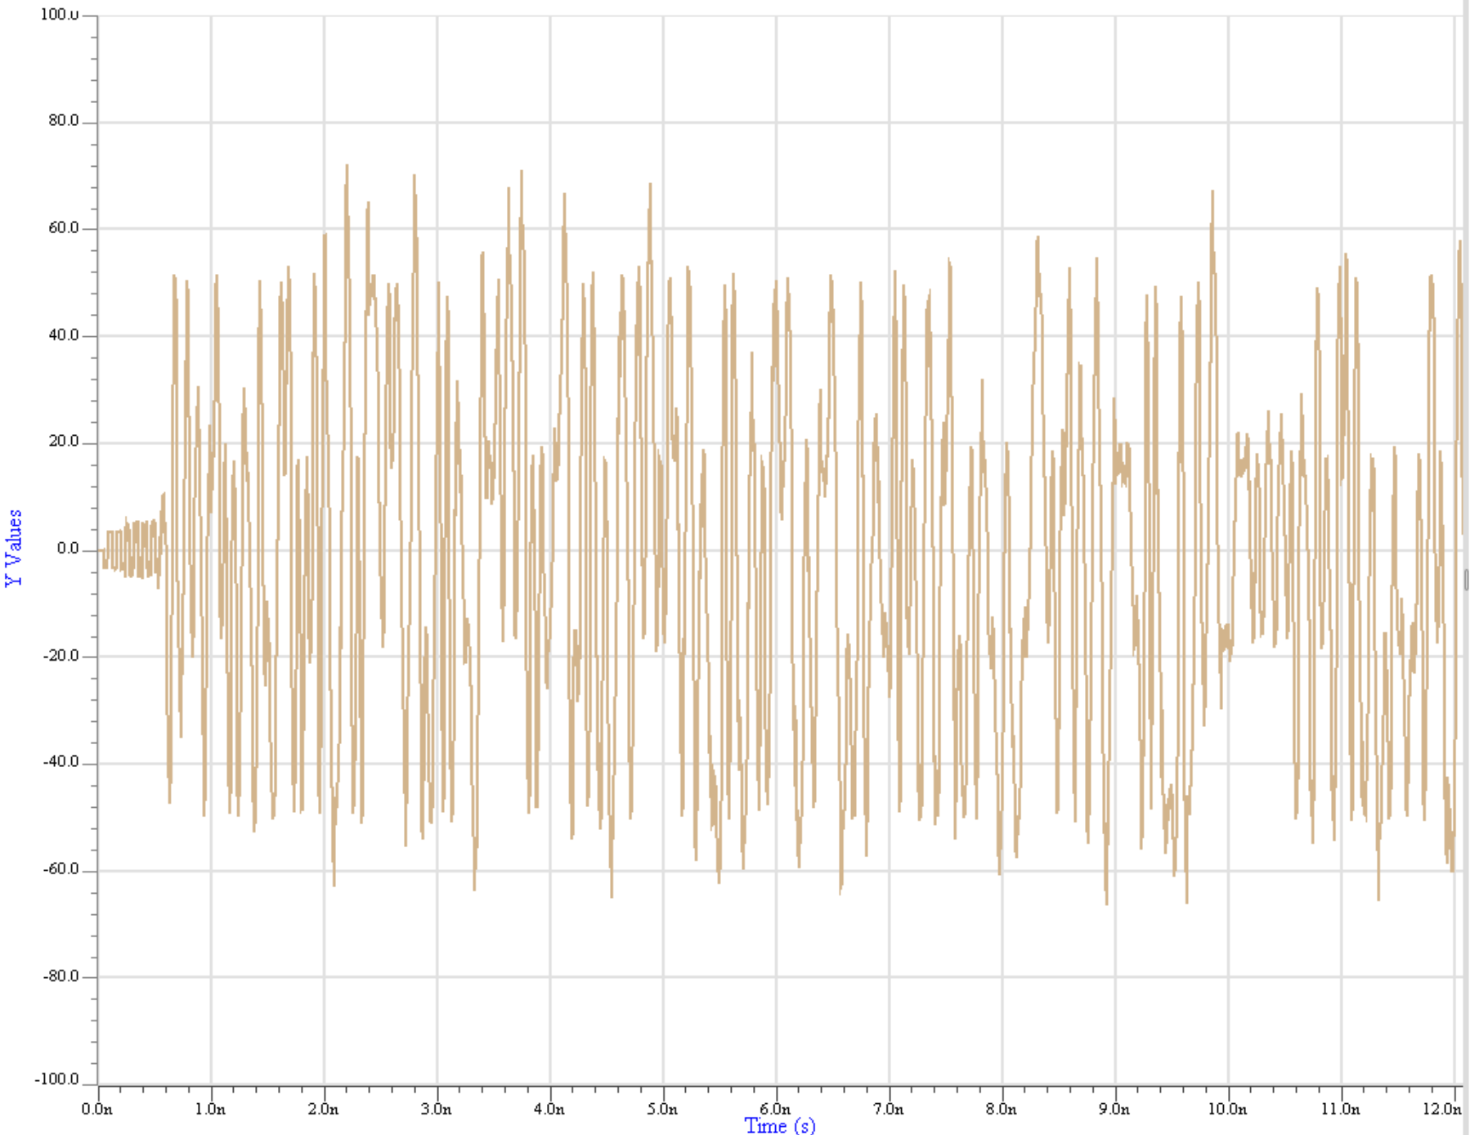
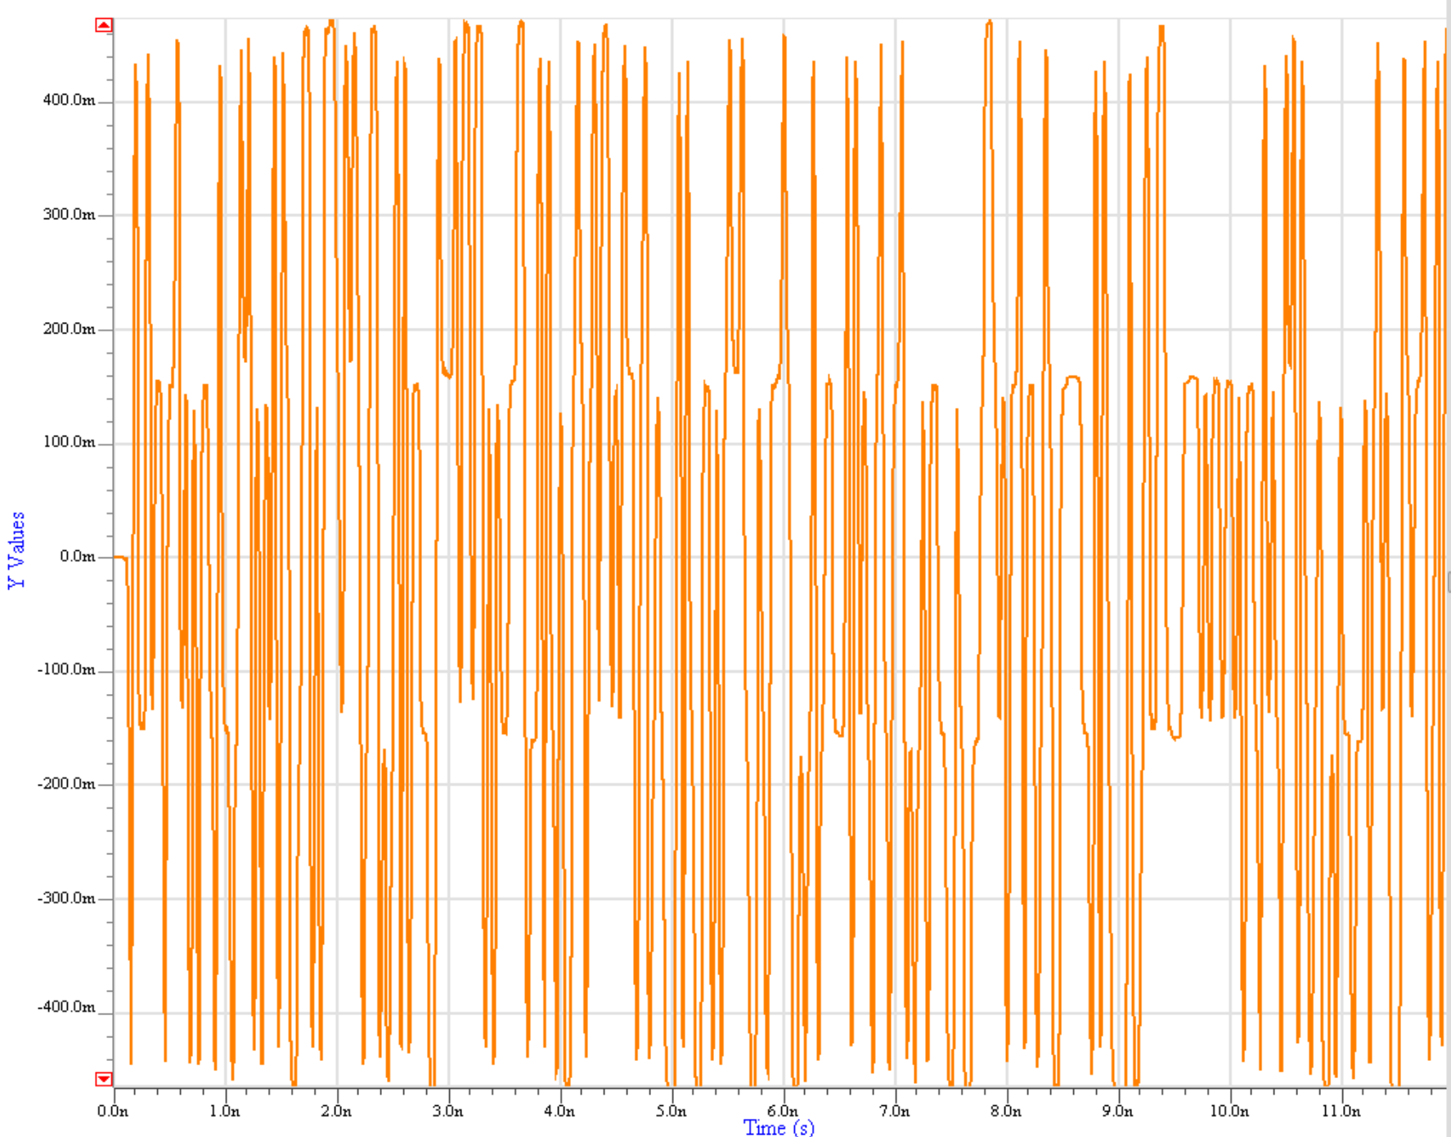
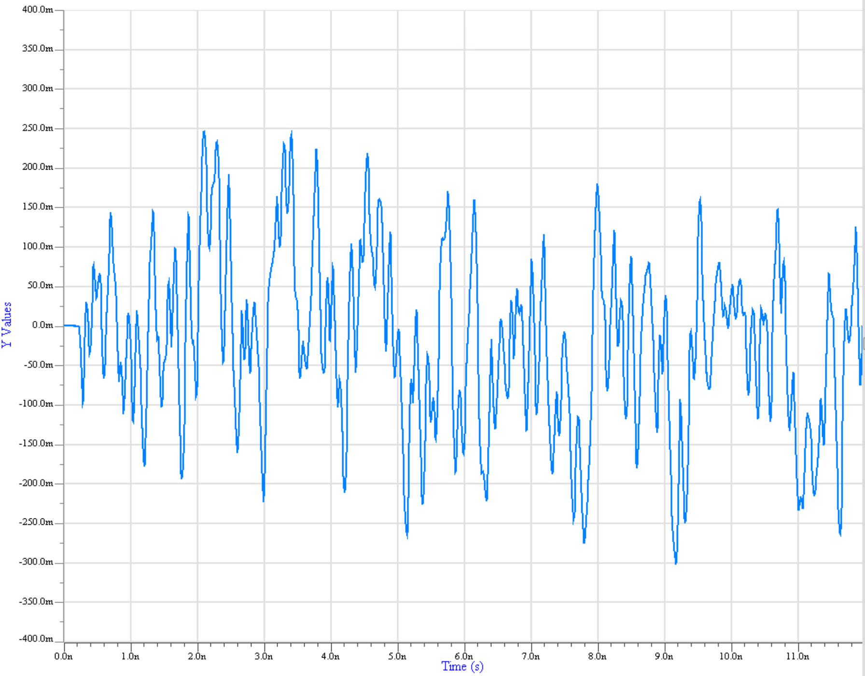
Bit-by-Bit Simulation Steps 4 to 7
Stimulus from the EDA tool
Rx Equalization & Filtering
4
g_{REG}[x(t)]
7
Rx AMI_GetWave() = True =>
Rx equalization and/or filtering
is applied to the Rx AMI_GetWave()
function
Analog waveform sent to EDA tool for processing
Tx AMI_GetWave() = True =>
Tx equalization and/or filtering
is applied to the Tx AMI_GetWave()
function
6
5
H_{AC}(t) * g_{TEG}[x(t)]
H_{TEI}(t) not used
H_{AC}(t)
g_{TEG}[x(t)]
Tx Equalization & Filtering

Slide 34
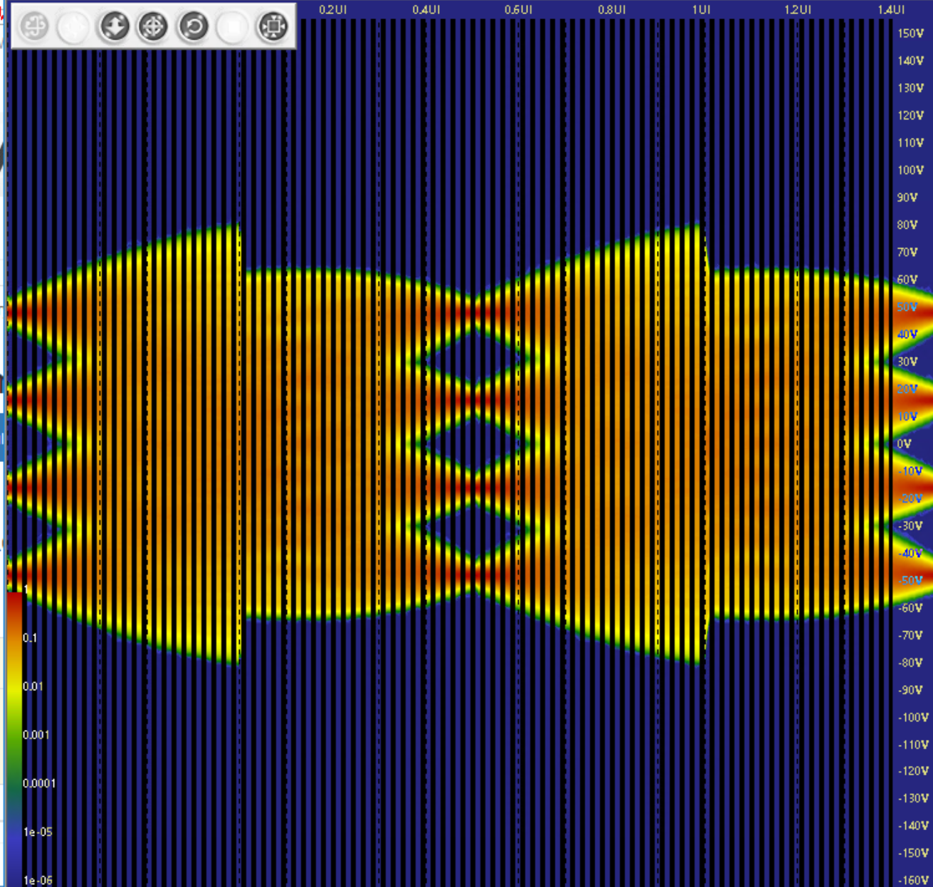
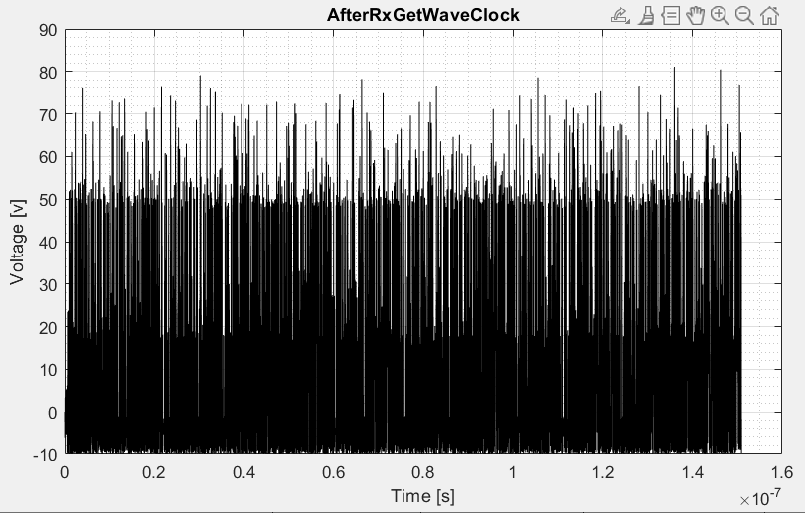
Bit-by-Bit Simulation Step 8
g_{REG}[x(t)]
7
8
g_{REG}[x(t)]*H_{AC}(t) * g_{TEG}[x(t)]
Rx Decision Point
Analog waveform sent to EDA tool for processing
Analog waveform
Clock
7

Slide 35
Example Time Domain /Bit-by-bit Mode
  Case 5 - The Tx model does have an AMI_GetWave() function, but the Rx doesn’t

Slide 36
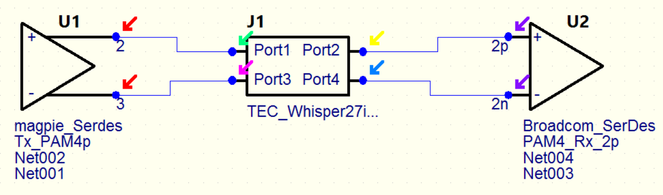
Bit-by-Bit Simulation Step 1
Step response
(from channel characterization)
1
Analog Channel Impulse response H_{AC}(t)
(the derivative of the step response)

Slide 37
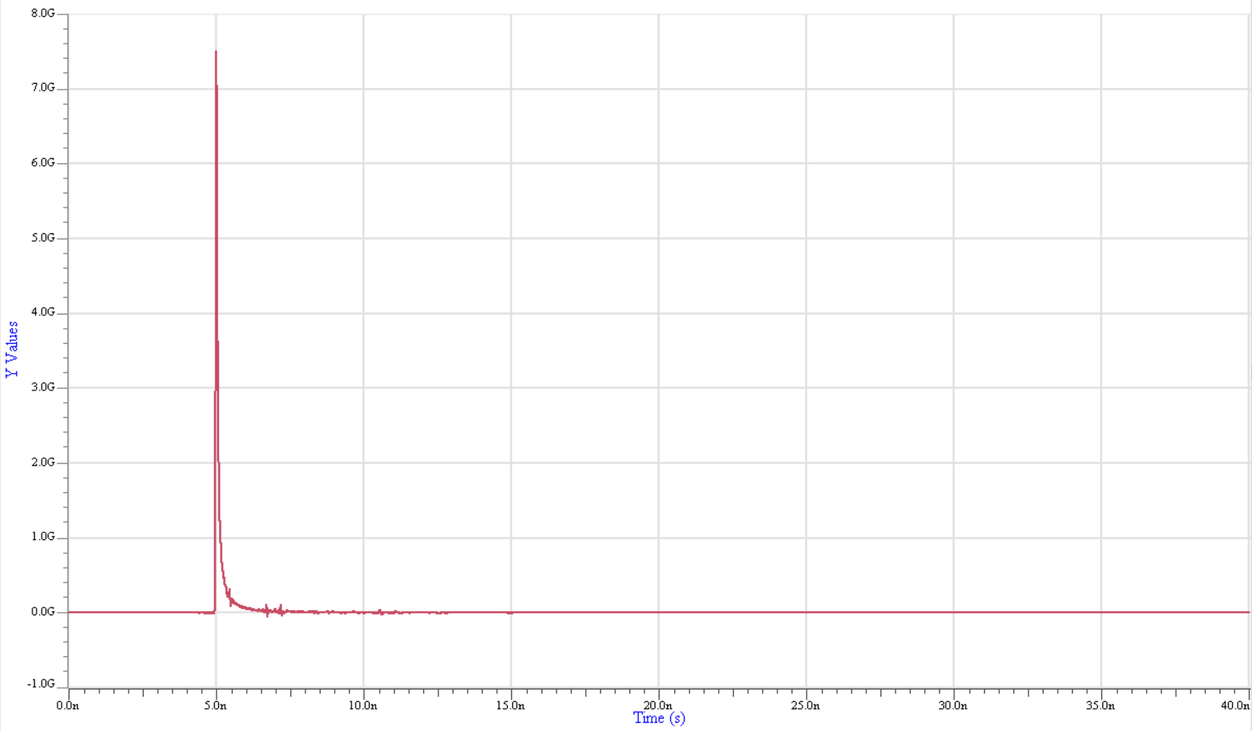
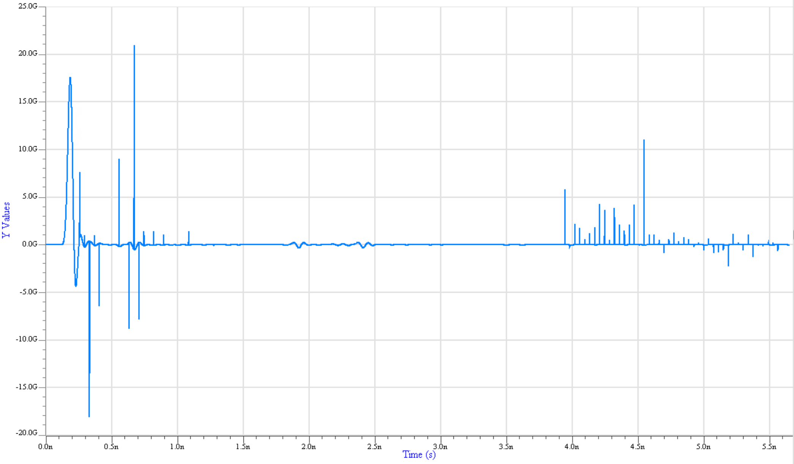
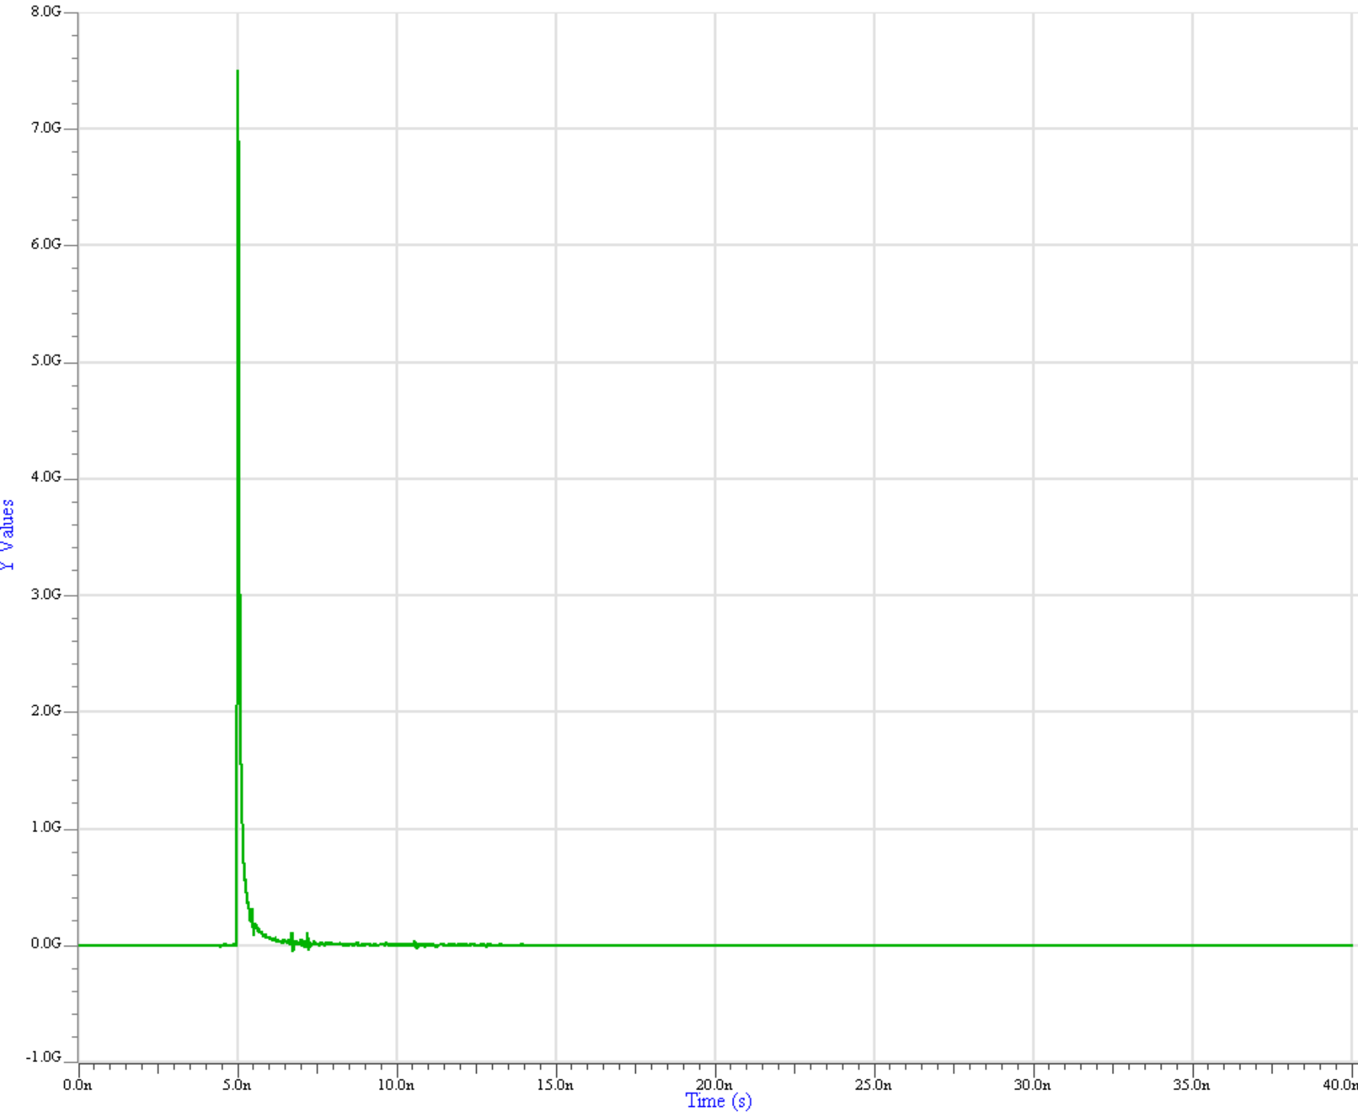
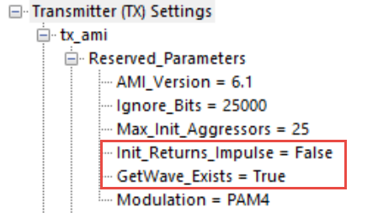
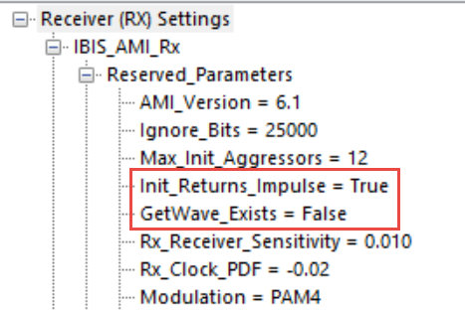
Bit-by-Bit Simulation Steps 2 and 3
H_{REI}(t)
H_{AC}(t)
2
3
Tx AMI-Init() = False
Tx equalization and/or filtering
is not applied to H_{AC}(t)
Rx AMI-Init() = True
Rx equalization and/or filtering
was applied
H_{TEI}(t) identical with H_{AC}(t)

Slide 38
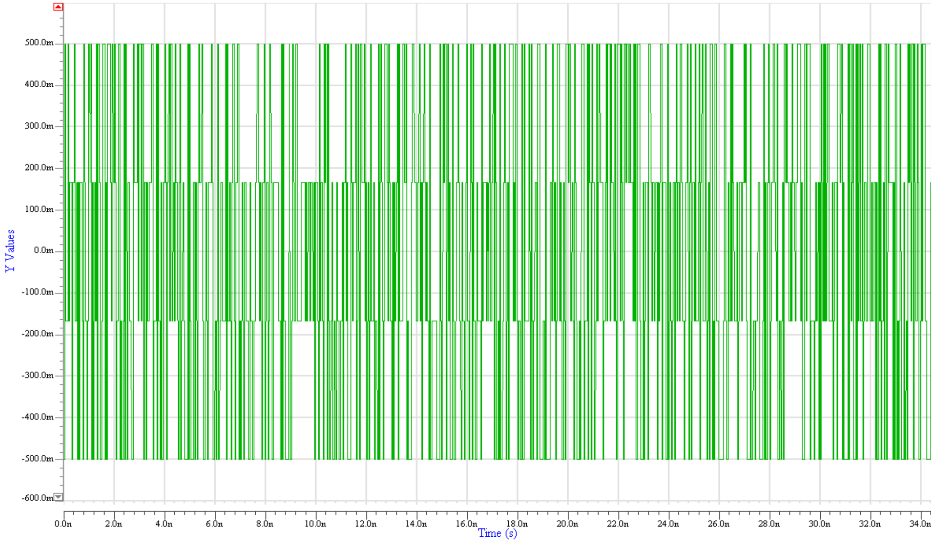
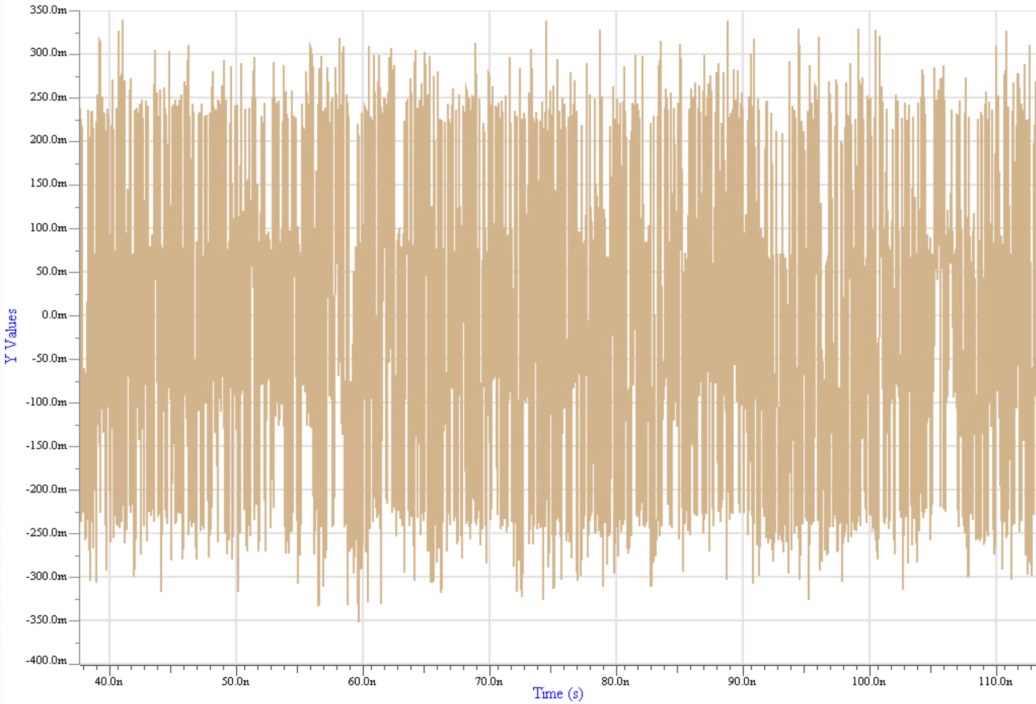
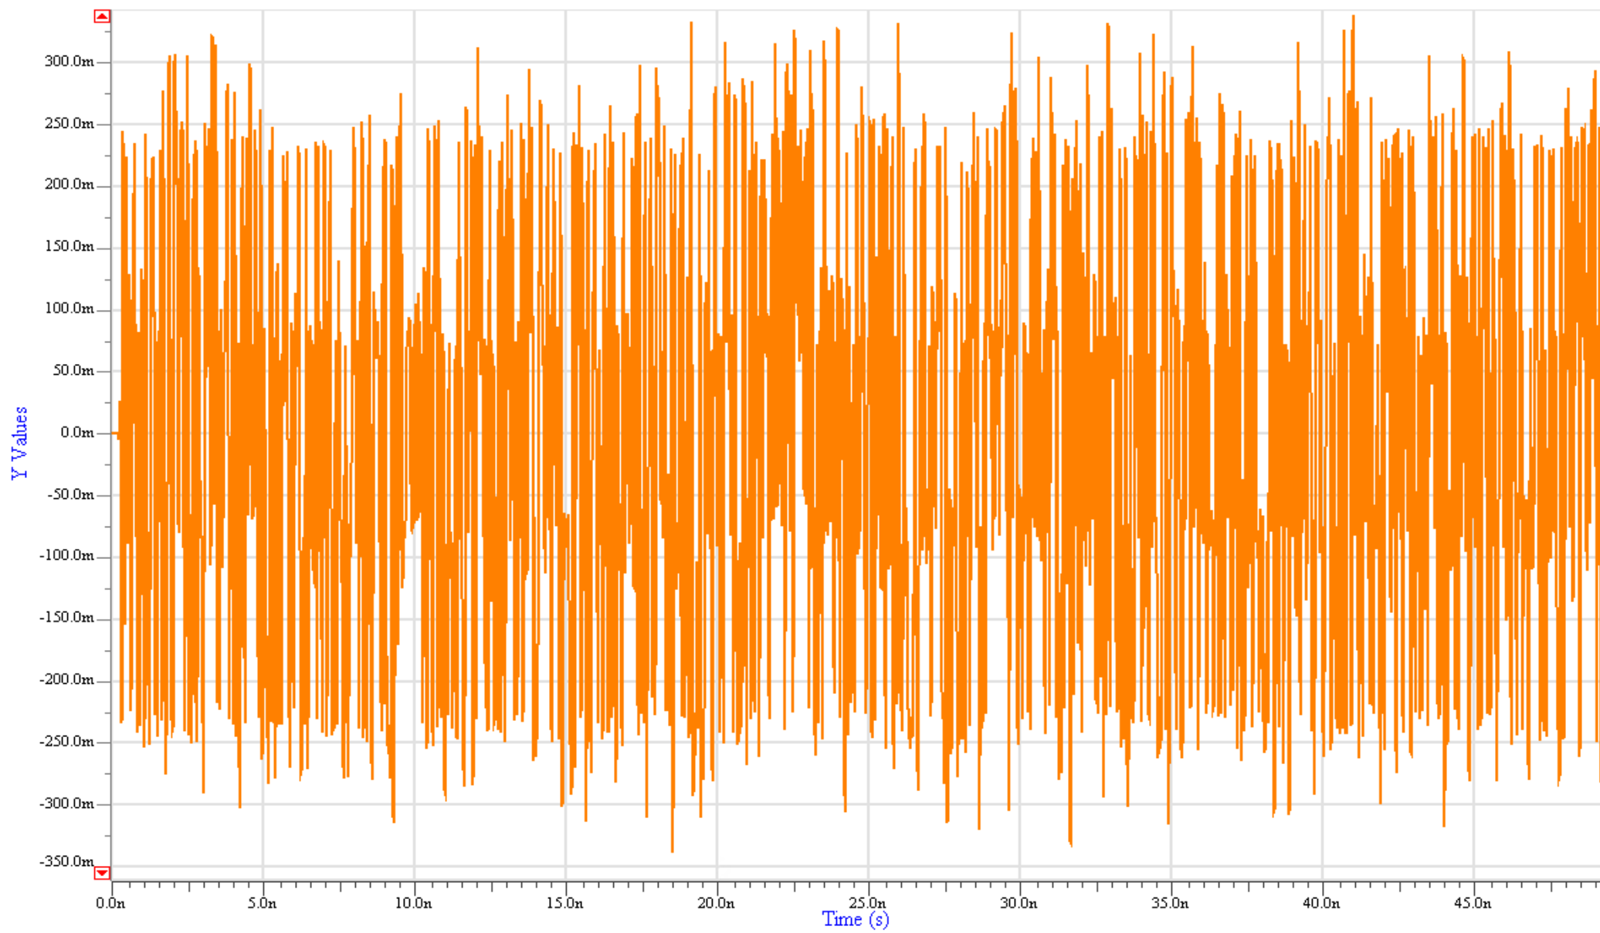
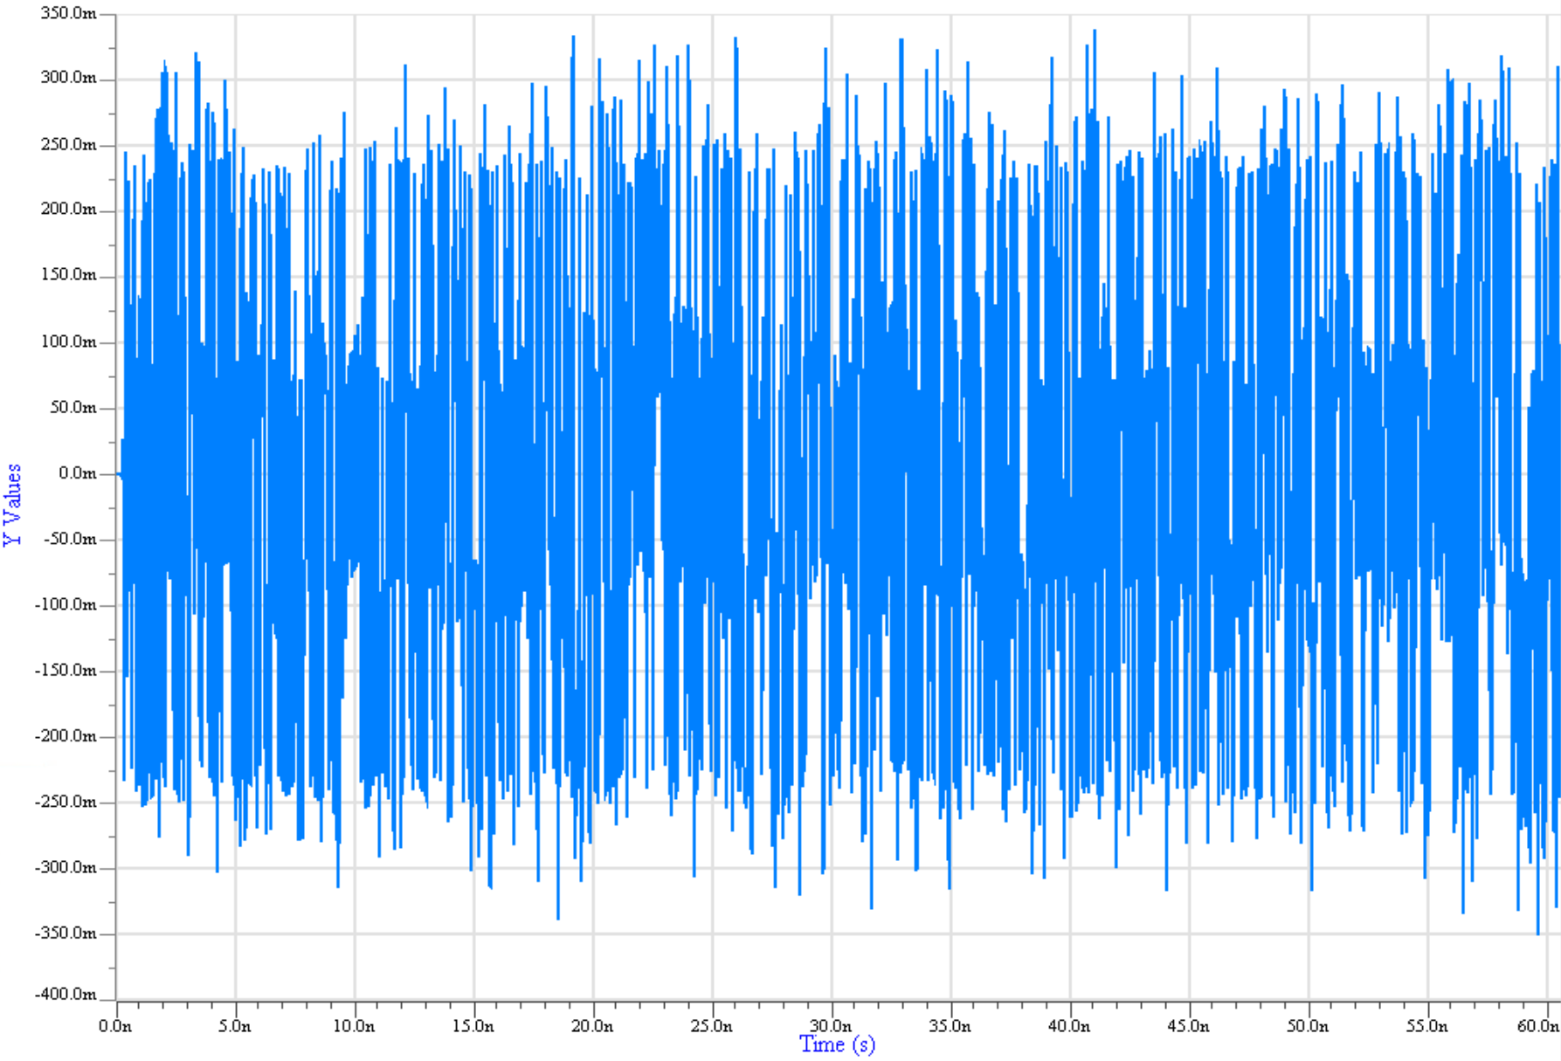
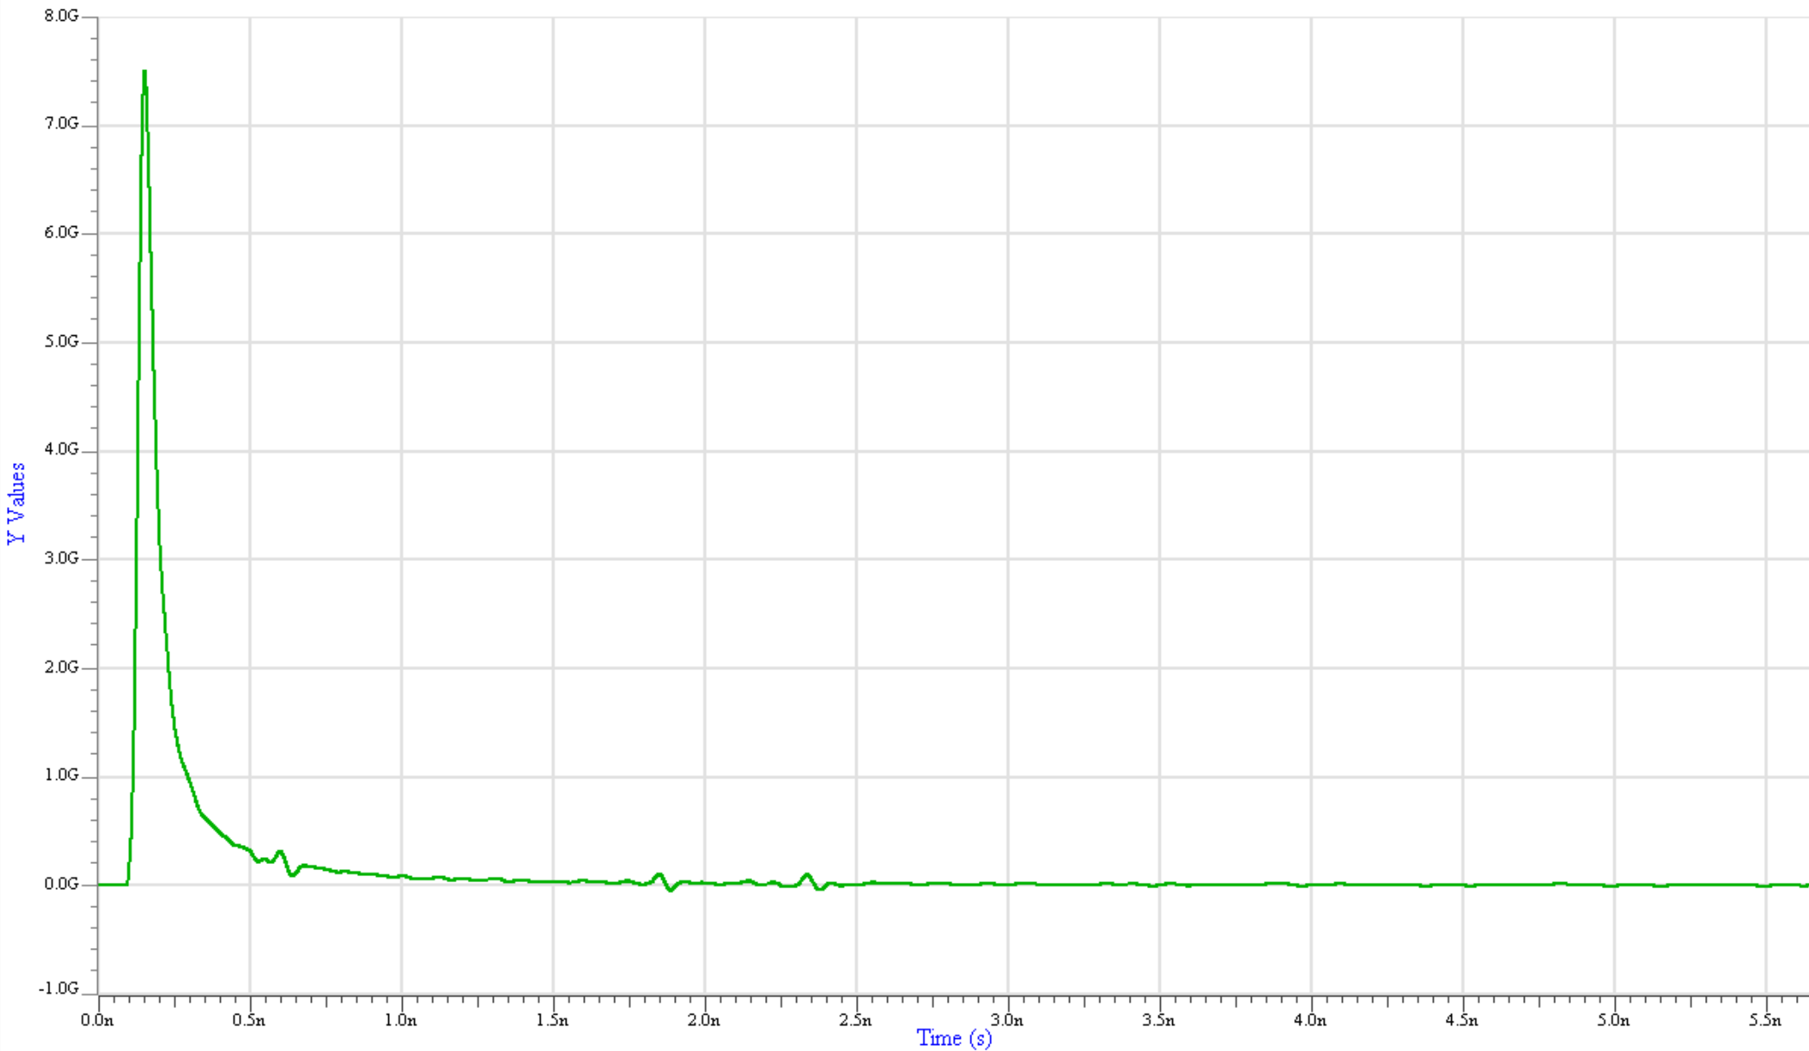
Bit-by-Bit Simulation Steps 4 to 7
Stimulus from the EDA tool
No Rx Equalization & Filtering
4
Virtual g_{REG}[x(t)]
7
Rx AMI_GetWave() = False =>
Rx equalization and/or filtering
is not applied to the Rx AMI_GetWave()
Function
Use H_{REI}(t) instead
Tx AMI_GetWave() = True =>
Tx equalization and/or filtering
is applied to the Tx AMI_GetWave()
function
5
6
H_{TEI}(t) * g_{TEG}[x(t)]
g_{TEG}[x(t)]
H_{TEI}(t) identical with H_{AC}(t)
Tx Equalization & Filtering

Slide 39
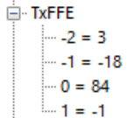
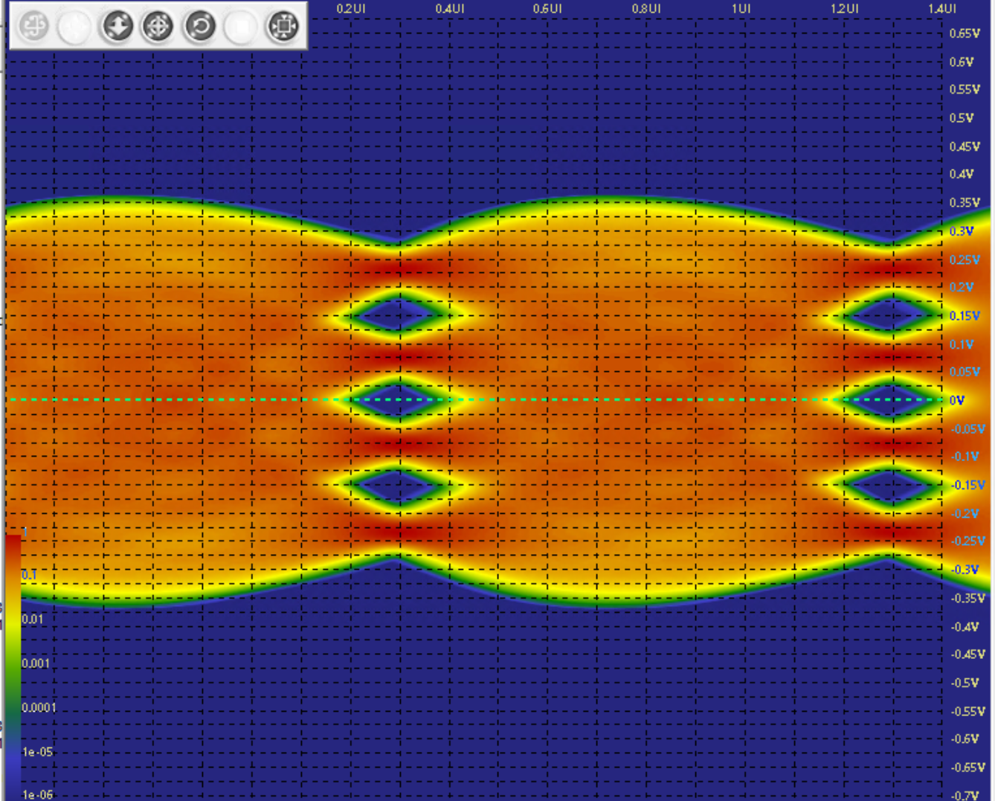
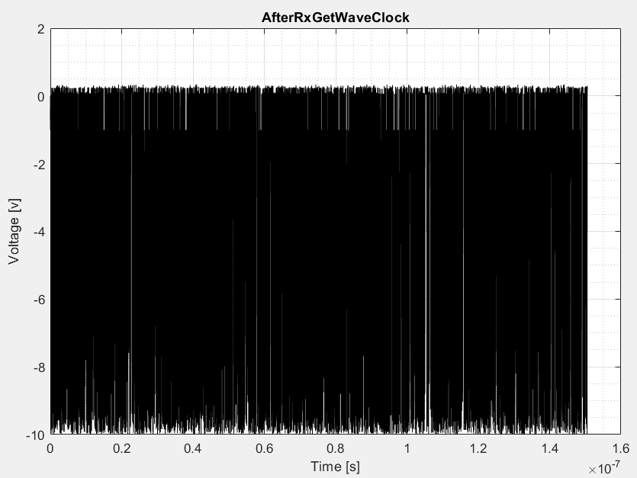
Bit-by-Bit Simulation Step 8
7
Tx FFE taps settings
H_{TEI}(t) * g_{TEG}[x(t)]
8
Analog waveform sent to EDA tool for processing
Rx Decision Point
H_{REI}(t) *H_{AC}(t) * g_{TEG}[x(t)]
Clock
7
H_{REI}(t)

Slide 40
Useful Links
IBIS Open Forum: https://ibis.org/
https://www.analog.com/en/resources/analog-dialogue/articles/spice-vs-ibis-choosing-the-more-appropriate-model-for-your-circuit.html
https://www.analog.com/en/resources/analog-dialogue/articles/ibis-modeling-part-1-why-ibis-modeling-is-critical-to-the-success-of-your-design.html
https://www.analog.com/en/resources/analog-dialogue/articles/ibis-modeling-part-2-why-and-how-to-create-your-own-ibis-model.html
https://www.analog.com/en/resources/analog-dialogue/articles/ibis-modeling-part-3-how-to-achieve-a-quality-level-3-ibis-model-through-bench-measurement.html
https://www.mathworks.com/discovery/ibis-ami.html
https://www.keysight.com/us/en/lib/resources/webcasts/ibisami-modeling-fundamentals-3111611.html

Slide 41
(JEDEC) Channel Operating Margin
(J)COM

Slide 42
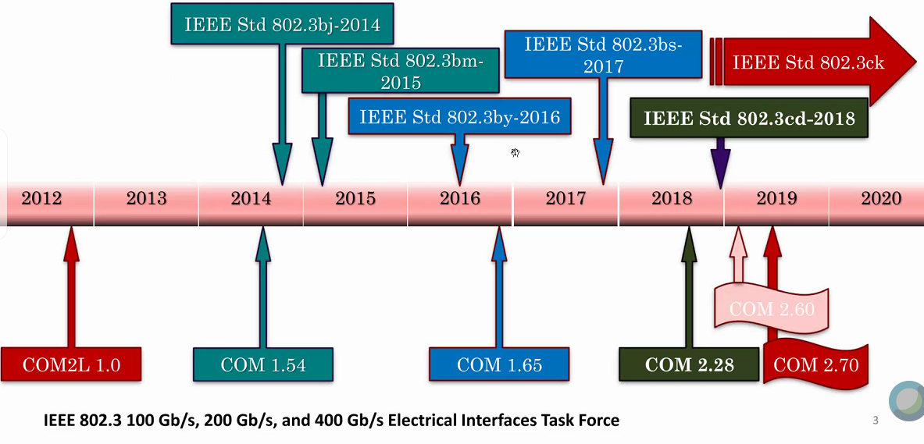
IEEE COM Timeline

Slide 43
Channel Operating Margin
IEEE P802.3bj has attempted to solve unification of TX, RX and channel specification using time domain specification
COM computation algorithm
  Statistical simulation of victim and aggressor using single bit pulse responses
  Unit interval pulse responses obtained from s-parameters
  TX and RX reference models are considered in the simulation
  Package representation and parasitic die loads considered
    Channel margin is a die-to-die metric
  Ratio of sampled available signal to total peak noise
    Threshold to mitigate discrepancy between reference chips and actual chip performance
    Decibel ratio of the voltage sample point over the noise at a specified BER is the “final answer” / figure of merit
COM calculation is done in the time domain
  Based on a mathematical algorithm which does not favor one EDA tool over another.

Slide 44

COM Outputs
The output of COM is a single value of a unified budget of the whole system calculated for two different test cases:
  A short package trace length (12mm) required to interact with reflective channels.
  A long package length (30mm) required to represent the loss in large packages more susceptible to noise.
  The near-end crosstalk path contains always a short package length.

Slide 45

JCOM – Compliance Method for JESD204C/C1
JCOM has its origins in the IEEE 802.3bj COM revision and was created by the TG16 task group of the Joint Electron Device Engineering Council (JEDEC) as part of its JESD204C standardization work.
JCOM is the compliance methodology for high-speed serial links connecting analog-to-digital data converters (ADC) and digital-to-analog converters (DAC) to logic devices such as FPGAs or ASICS.
JCOM represents the signal-to-noise ratio (SNR) at the output of the receiver and is calculated as the decibel ratio of the signal amplitude A_{s} over the noise amplitude A_{ni}:
$$JCOM=20∙\log_{10}\left(\frac{A_{S}}{A_{ni}}\right)$$

Slide 46
JCOM – Compliance Method for JESD204C/C1 (cont.)
Several improvements compared to the IEEE 802.3 COM have been incorporated in the transceivers and package models:
  The output/input impedances of the transceivers are modeled as frequency dependent return loss as opposed to a constant resistance.
  Added support for custom device and package models.
  Model makers have complete freedom regarding package scattering parameters to be used in the simulations.
  The FFE, CTLE and DFE are encapsulated in the device models and can report the number of available settings.
The computational algorithm is similar to the one from IEEE 802.3 COM, but the equalization optimization is performed for each possible combination of transmitter/receiver lanes and transmitter rise/fall times.
JCOM is calculated as the minimum value resulting from all of those combinations, and it is compared to a 2dB threshold for channel compliance checking.

Slide 47



(J)COM Link Model Overview
COM: Simulation core
JCOM: Silicon vendor
Link designer
COM: Simulation core
JCOM: Silicon vendor
k=[0, … , 2N+2M] paths that make up channel (provided as 4-port S-parameter files)

Slide 48
COM Link Model

Slide 49
JCOM Link Model

Slide 50









(J)COM Computational Procedure (FD: Steps 1 and 2)
$$S^{\left(k\right)}\left(f\right)$$
COM:
$$Γ_{1}=\frac{R_{d}−R_{0}}{R_{d}+R_{0}}$$
COM:
$$Γ_{2}=\frac{R_{d}−R_{0}}{R_{d}+R_{0}}$$
JCOM:
$$Γ_{1}=\frac{Z_{d}\left(f\right)−R_{0}}{Z_{d}\left(f\right)+R_{0}}$$
JCOM:
$$Γ_{2}=\frac{Z_{d}\left(f\right)−R_{0}}{Z_{d}\left(f\right)+R_{0}}$$
Channel’s partial
4-port parameters
From transmitter model
From receiver model
$$R_{d}$$
$$R_{d}$$
or
or
$$Z_{d}\left(f\right)$$
$$Z_{d}\left(f\right)$$
Tx package
Rx package

Slide 51




(J)COM Computational Procedure (FD: Steps 3 and 4)
COM:
$$TA\left(f_{0},f\right)=1$$
$$H_{21}^{\left(k\right)}\left(f\right)=TA\left(f_{0},f\right)∙\frac{s_{21}^{\left(k\right)}\left(f\right)∙\left(1−Γ_{1}\right)∙\left(1+Γ_{2}\right)}{1−s_{11}^{\left(k\right)}\left(f\right)∙Γ_{1}−s_{22}^{\left(k\right)}\left(f\right)∙Γ_{2}+Γ_{1}∙Γ_{2}∙∆S\left(f\right)}$$
JCOM:
$$TA\left(f_{0},f\right)=LPF(f_{0},f)$$
Scalar transfer function
4th order Bessel low-pass filter, to control Tx rise/fall time
From transmitter model
$$H_{r}\left(f\right)=\frac{1}{\text{1}−\text{3.414214}∙{\left(\frac{f}{f_{r}}\right)}^{\text{2}}+{\left(\frac{f}{f_{r}}\right)}^{\text{4}}+j∙\text{2.613126}∙\left(\frac{f}{f_{r}}−{\left(\frac{f}{f_{r}}\right)}^{\text{3}}\right)}$$
From receiver model in JESD204C-1 proposal
Apply Rx noise filter

Slide 52

(J)COM Computational Procedure (FD: Steps 5 and 6)
IFFT
Non-equalized step response
Voltage transfer function with Rx filter applied
$$H^{\left(k\right)}\left(f\right)=H_{21}^{\left(k\right)}\left(f\right)∙H_{r}\left(f\right)$$

Slide 53


(J)COM Computational Procedure (TD: Steps 1 and 2)
FEXT aggressor
NEXT aggressor
Victim channel
Non-equalized channel transfer function
Non-equalized channel transfer function
Non-equalized channel transfer function
$$h^{\left(k\right)}\left(t\right)=\int_{−∞}^{∞}{X\left(f\right)∙}H^{\left(k\right)}\left(f\right)∙e^{j∙\text{2}∙π∙f∙t}∙df$$
with
$$X\left(f\right)=A_{t}∙T_{b}∙sinc\left(f∙T_{b}\right)$$
JCOM: from transmitter model

Slide 54



(J)COM Computational Procedure (TD: Steps 2 and 3)
Victim channel
FEXT aggressor
NEXT aggressor
JCOM: from transmitter model
$$H_{ctf}\left(f\right)=\frac{{10}^{\frac{g_{DC}}{20}}+j∙\frac{f}{f_{z}}}{\left(1+j∙\frac{f}{f_{p_{1}}}\right)∙\left(1+j∙\frac{f}{f_{p_{2}}}\right)}$$
COM:
$$H_{ffe}\left(f\right)=\sum_{i=−\text{1}}^{\text{1}}{c\left(i\right)∙e^{−j∙\text{2}∙π∙\left(i+\text{1}\right)∙\frac{f}{f_{b}}}}$$
JCOM:
$$H_{ctf}\left(f\right)=H_{ctf}\left(setting, f\right)$$
From receiver model
Equalized response: Tx FFE + Rx CTLE
Equalized response: Rx CTLE
Equalized response: Rx CTLE

Slide 55









(J)COM Computational Procedure (TD: Step 4)
Computation core finds FFE, CTLE
settings that maximizes FOM
From receiver model in JESD204C-1 proposal
$$FOM=\text{10}∙\log_{\text{10}}\left(\frac{A_{s}^{\text{2}}}{σ_{TX}^{\text{2}}+σ_{ISI}^{\text{2}}+σ_{J}^{\text{2}}+σ_{XT}^{\text{2}}+σ_{N}^{\text{2}}}\right)$$
$$A_{s}$$
Single-bit response (SBR) amplitude
From transmitter model
$$σ_{ISI}$$
Variance of amplitude due to inter-symbol interference
$$σ_{J}$$
Variance of amplitude error due to timing jitter
$$σ_{XT}$$
Worst-case amplitude variance due to all cross-talk paths
$$COM=20∙\log_{10}\left(\frac{A_{S}}{A_{ni}}\right)$$
$$σ_{N}$$
Variance of noise at output of receiver CTLE
$A_{ni}$ (Noise)
Peak-to-peak noise amplitude at sampling point for given BER

Slide 56
Effective Return Loss (ERL)

Slide 57


RL vs. ERL – Example of a “false negative” case
Let’s consider the channel shown below:
Via stub length = 48.2 mils

Slide 58



50GBASE-KR Analysis
Insertion Loss (IL) Plot
Return Loss (RL) Plot
Channel Operating Margin (COM)

Slide 59


Computational Steps of ERL
Somewhat similar to that from COM:
  Starts with a 4-port scattering parameter of the channel or Tx/Rx package
  Filtered return loss H_{ii}(f) is calculated first by multiplying the return loss s_{ii}(f) with transmitter filter H_{t}(f) and receiver noise filter H_{r}(f)
sii(f)
Hii(f) = Ht(f)sii(f)Hr(f)
Hii(f)

Slide 60



Computational Steps of ERL (cont.)
The pulse time-domain reflection (PTDR) signal is derived from the filtered return loss:
$$PTDR\left(t\right)= \int_{−∞}^{∞}{X(f)Hii(f)exp(j2πft)df }$$
Where
$$X\left(f\right)=Tbsinc(fTb)$$
and Tb = 1/fb is the unit interval
PTDR(t)
Hii(f)

Slide 61


Computational Steps of ERL (cont.)
To account for the effect of DFE and IL on the reflected signal, the PTDR waveform is multiplied by two time gating and weighting functions called G_{rr}(t) and G_{loss}(t).
The resulting signal is the effective reflection waveform R_{eff}(t):
  $$Reff\left(t\right)=PTDR\left(t\right)∗Grr\left(t\right)∗Gloss(t)$$
PTDR(t)
Reff(t)

Slide 62




Computational Steps of ERL (cont.)
  The two time gaiting weighting functions are calculated with formulas:
Gloss(t)
Grr(t)

Slide 63


Computational Steps of ERL (cont.)
The ERL of the channel is computed from the Reff(t) waveform using a methodology that is similar to COM and includes the computations of the effective reflection probability density function (PDF) and the effective reflection cumulative distribution function (CDF).
Where $P^{−1}$ is the inverse distribution function or quantile function and DER₀ is the target detector error ratio. ERL of a channel is the smallest among the two values E₁₁ and E₂₂.
$ERL=20∗\log_{10}{P^{−1}}$(DER₀)

Slide 64
Simulated Results for Channel Under Investigation
The simulated ERL value for the channel under consideration is 16.58dB, which is above the threshold value of 11dB defined in the standard for the 50GBASE-KR operating mode.
This proves that ERL is tracking COM and consequently it is a more efficient and accurate method than the traditional RL and its associated mask.

Slide 65
Summary and Conclusions
As the demand for higher data rates goes up, the complexity of the transceivers increases, and the channel requirements become tighter.
The industry is continuously searching for new compliance methods that can address those new requirements.
IBIS-AMI has been traditionally the simulation method for SerDes.
Channel Operating Margin and Effective Return Loss have recently emerged as new compliance methods for SerDes protocols operating at 50Gbps and above.
IBIS-AMI models can be more accurate for specific silicon implementation, whereas COM and ERL are more effective in the earlier stages of design exploration.
Since no analysis method is perfect, a combination of various techniques is recommended for successful design.

Slide 66
References
IEEE Std 802.3bj™-2014, IEEE Standard for Ethernet, Amendment 2: Physical Layer Specifications and Management Parameters for 100 Gb/s Operation Over Backplanes and Copper Cables
JESD204C, JEDEC Standard for Serial Interface for Data Converters, December 2017
Optical Internetworking Forum – Clause 28: CEI-112G-LR-PAM4 Long Reach Interface, Implementation Agreement OIF-CEI-05.0, Draft March 24, 2019
Optical Internetworking Forum – Clause 23: CEI-112G-VSR-PAM4 Very Short Reach Interface, Implementation Agreement OIF-CEI-05.0, Draft April 15, 2019
Brandon Gore, Richard Mellitz, An Exercise in Applying Channel Operating Margin (COM) for 10GBASE-KR Channel Design

Slide 67
Useful Links
https://blogs.sw.siemens.com/electronic-systems-design/author/cfilip/
https://www.signalintegrityjournal.com/articles/2663-ber--and-com-way-of-channel-compliance-evaluation
https://www.signalintegrityjournal.com/articles/2712-efficient-sensitivity-aware-assessment-of-high-speed-links-using-pce-and-implications-for-com
https://www.ieee802.org/3/dj/public/tools/index.html
https://www.oiforum.com/wp-content/uploads/OIF-CEI-05.2.pdf
https://www.ieee802.org/3/bj/public/jul12/mellitz_01_0712.pdf
https://dl.cdn-anritsu.com/en-us/test-measurement/files/Technical-Notes/White-Paper/11410-00989A.pdf
https://ieeexplore.ieee.org/stamp/stamp.jsp?tp=&arnumber=9401322
https://blog.samtec.com/wp-content/uploads/2020/07/07_02_2020_geek_speek_IEEE_COM.pdf

Slide 68
Free SI/PI Tools
IEEE MATLAB Script for COM - P802.3df Channel / Tool (ieee802.org)
Free IBIS Simulator: https://ee-training.dk/simulation/free-ibis-simulator-kicad-8.htm
Free IBIS-AMI Simulator PyBERT - Home · capn-freako/PyBERT Wiki · GitHub
Circuit Simulator Qucs - https://qucs.sourceforge.net/
EM Field Solver OpenEMS - https://www.openems.de/
Spice Simulator KiCad with integrated ngspice - https://www.kicad.org/discover/spice/
Touchstone Viewer SnPView (online viewer) – https://snpview.com/
Teledyne LeCroy MAUI Studio WavePulser Interface - https://www.teledynelecroy.com/mauistudio/
Ansys Student Version - https://www.ansys.com/academic/students
ADS free student version - https://edaapps.software.keysight.com/cgi-bin/eda-evaluation/request.cgi?product=ads&cc=US&lc=eng
General PCB Analysis tools:
  Saturn PCB tools: https://saturnpcb.com/saturn-pcb-toolkit/
  Sierra Circuits online calculators: https://www.protoexpress.com/tools/
  Free PDN analyzer: https://www.pdntool.com/

Slide 69
Module 6

Slide 70
Reflect on what we discussed today (5mins)
Discuss with your Seatmate.

Slide 71
Takeaways Points
Course Logistics.
Course Overview.
Three compliance methods: Eye Diagrams, Frequency Domain Metrics and Channel Operating Margin

