Slide 1

Introduction to Signal Integrity
please scan QR code for attendance

Slide 2

S-Parameters and VNA

Slide 3
Module 1

Slide 4
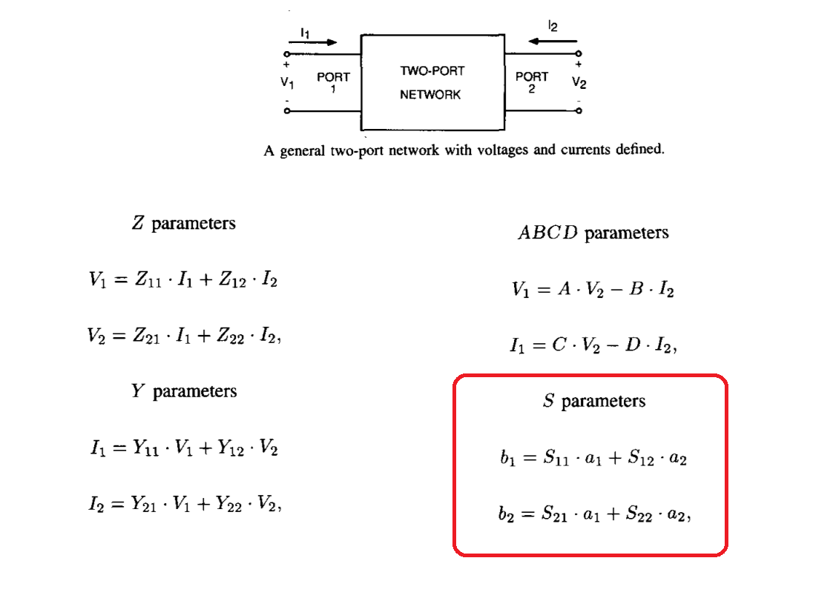
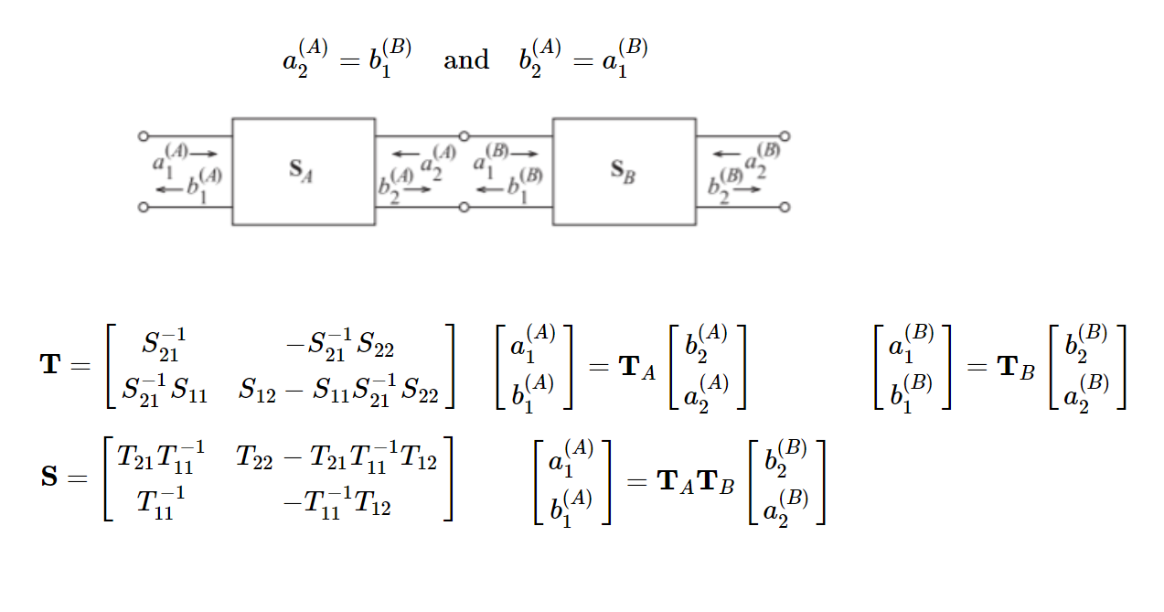

Circuit parameters

Slide 5
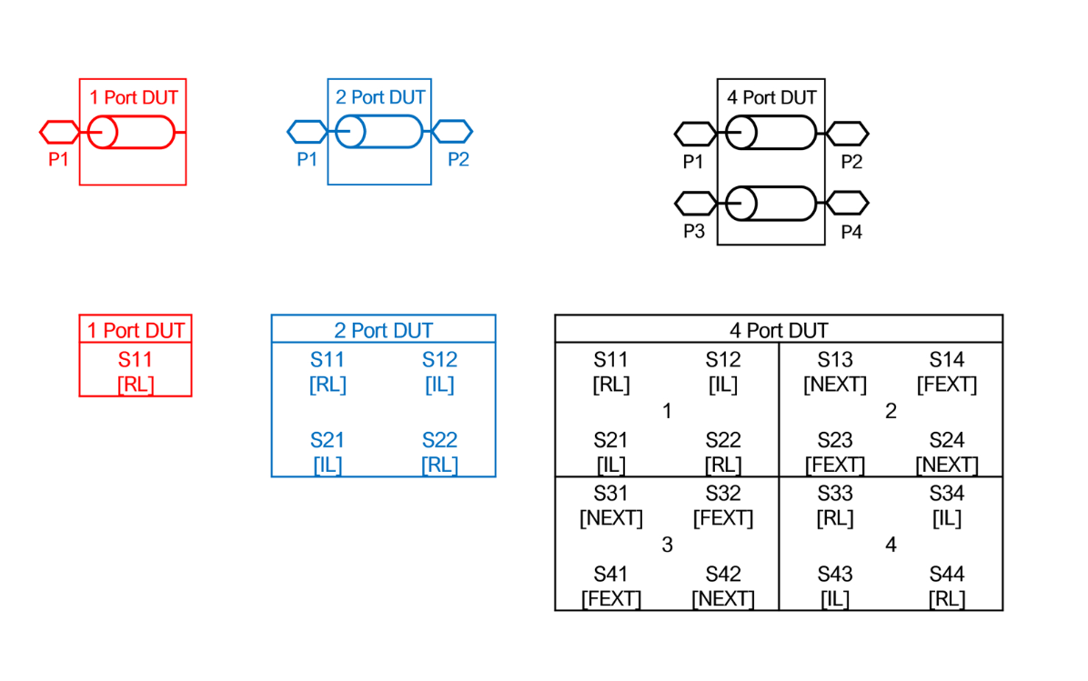
Multi-Port S-Parameters

Slide 6
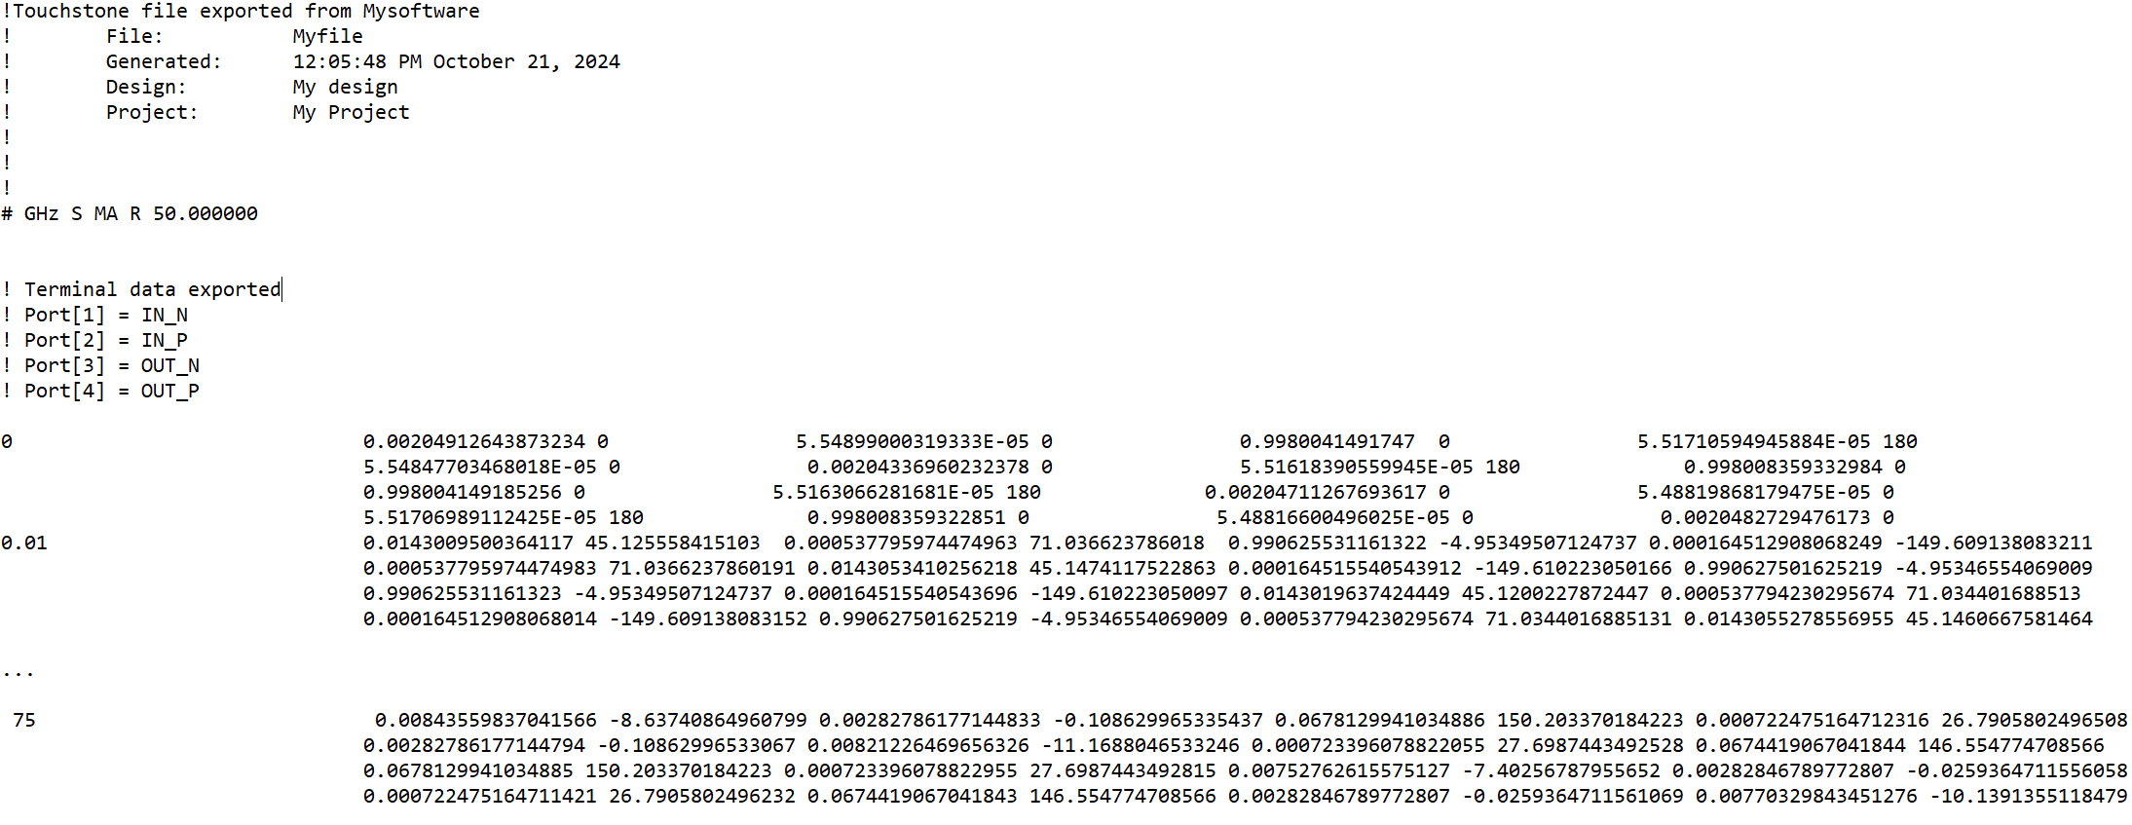
Touchstone Format (Snp)
# GHz S MA R 50

Slide 7
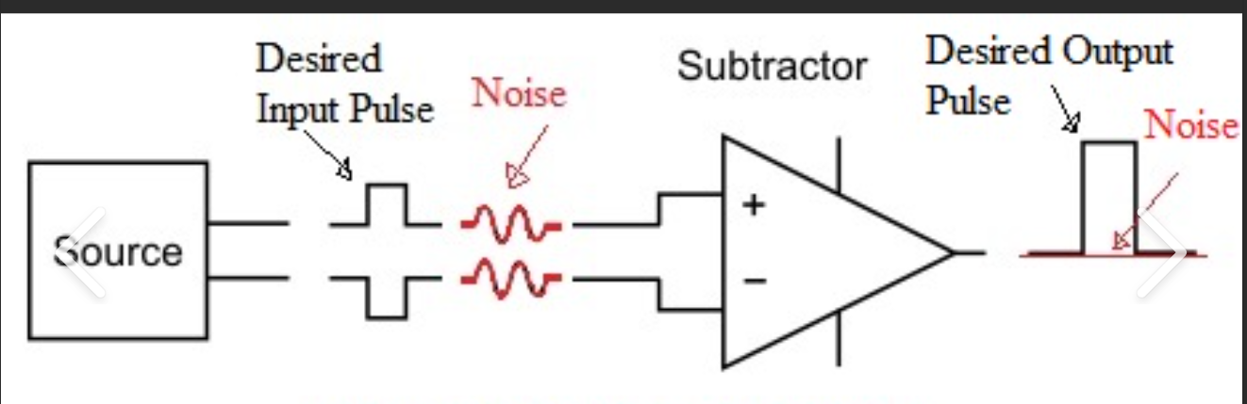
Differential Signalling

Slide 8
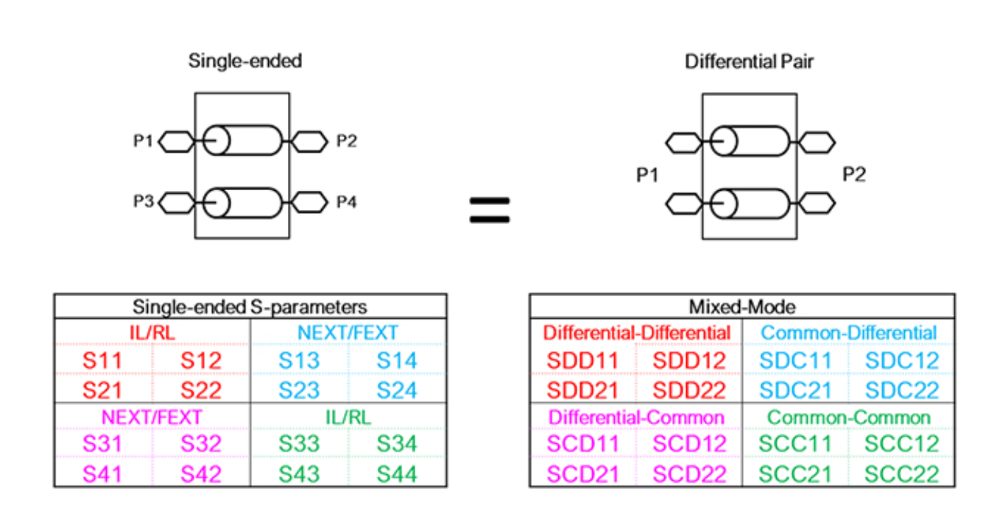
Differential S-Parameters

Slide 9
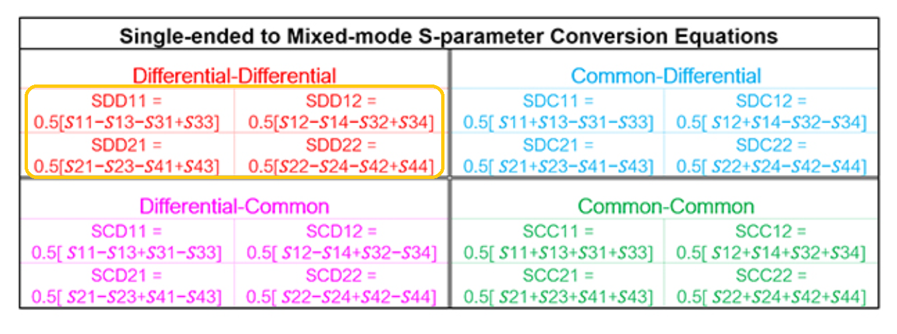
Differential S-Parameters
SDD21 = 0.5 [S12 + S34 –(S13+S32)]

Slide 10
Module 2

Slide 11
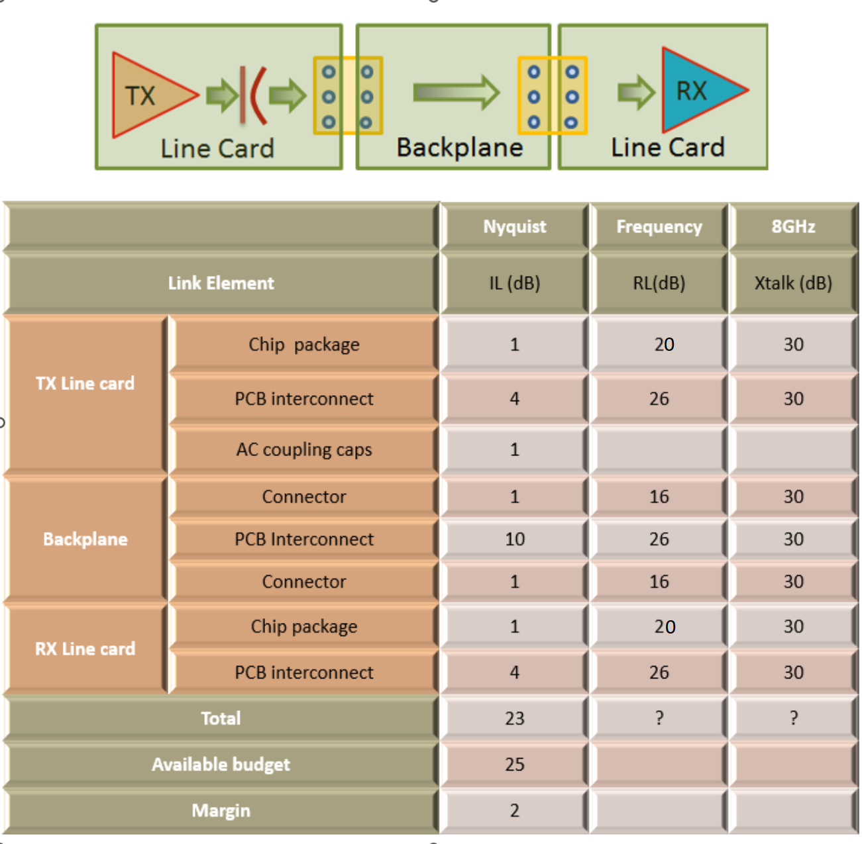
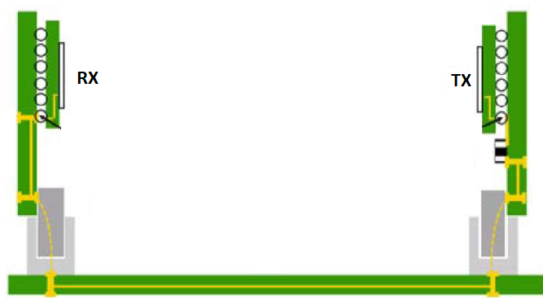
Cascading S -Parameters

Slide 12
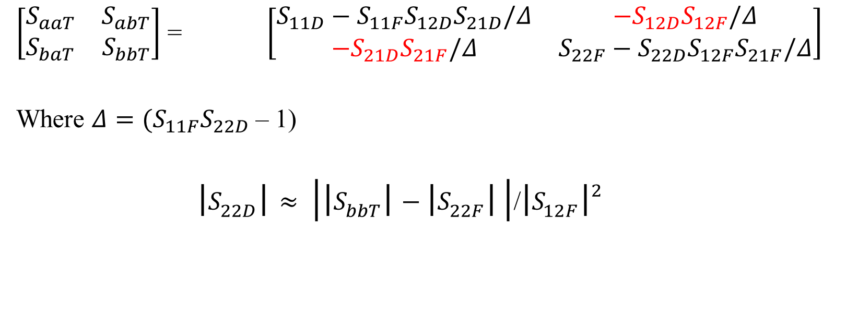
2 Cascaded 2 port networks and Link Budgets
a
1
2
1
2
b
D
F
T
$\left[\begin{matrix}S_{aaT} & S_{abT} \\ S_{baT} & S_{bbT}\end{matrix}\right]$ = $\left[\begin{matrix}S_{11D}−S_{11F}S_{12D}S_{21D}/Δ & {−S}_{12D}S_{12F}/Δ \\ {−S}_{21D}S_{21F}/Δ & S_{22F}−S_{22D}S_{12F}S_{21F}/Δ\end{matrix}\right]$
Where $Δ={(S}_{11F}S_{22D}$– 1)
$\left|S_{22D}\right|≈ \left|\left|S_{bbT}\right|−\left|S_{22F}\right| \right|$/${\left|S_{12F}\right|}^{2}$

Slide 13

Question
I have TWO 50 OHM CABLES
If I Connect THEM TOGETHER
Will the Impedance of The NEW CABLE be
50 OHMS?

Slide 14
Answer
Yes

Slide 15
Answer
NO

Slide 16
Answer
It depends

Slide 17
Rephrase Question
If you are given 2 s-parameter files of two different 50 OHM cables and asked to run a simulation and compute impedance-
Will the Impedance of The NEW CABLE be
50 OHMS?

Slide 18
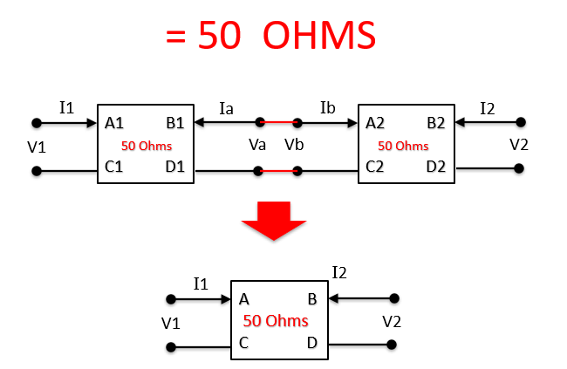
Answer from Simulations

Slide 19
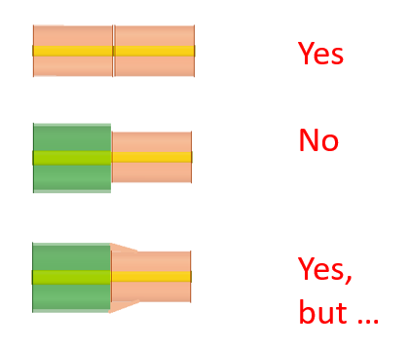
All answers are correct based on how one perceives the question

Slide 20
Take away
Simplification of S-parameters of cascaded networks while being “EXACT” in a circuit sense, is ONLY a good approximation in the “Electromagnetic Sense”. There are situations where a “blind” application can lead to incorrect results.

Slide 21
Module 3

Slide 22
Measurements
When a measurement of any object
affects that object
It is impossible
To make a perfect Measurement!

Slide 23
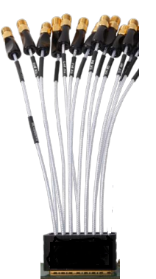
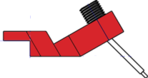
Calibration and De-Embedding

Slide 24
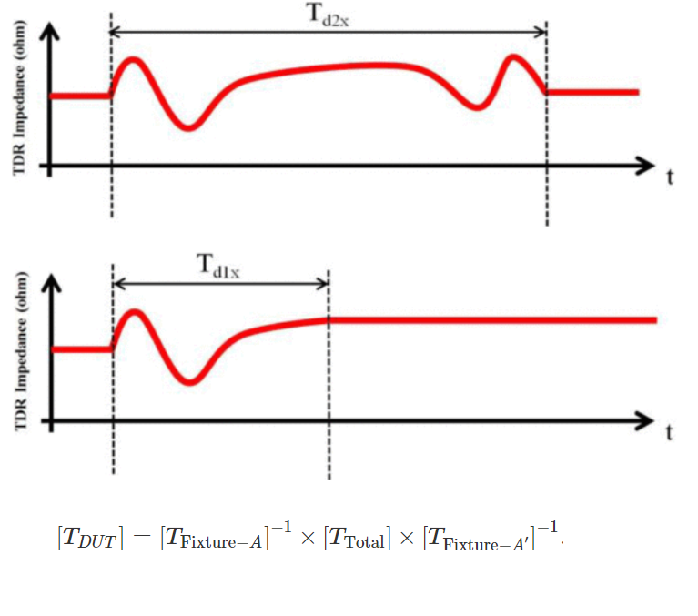
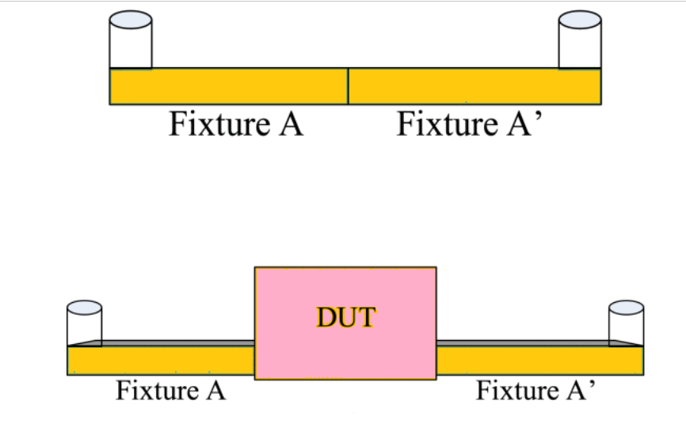
2X THRU

Slide 25
Module 4 VNA DEMO

Slide 26
Module 5

Slide 27
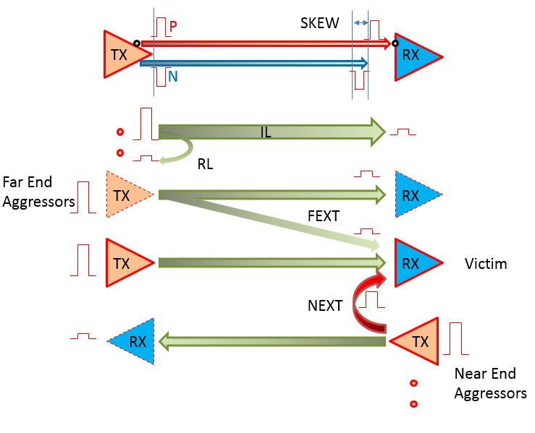
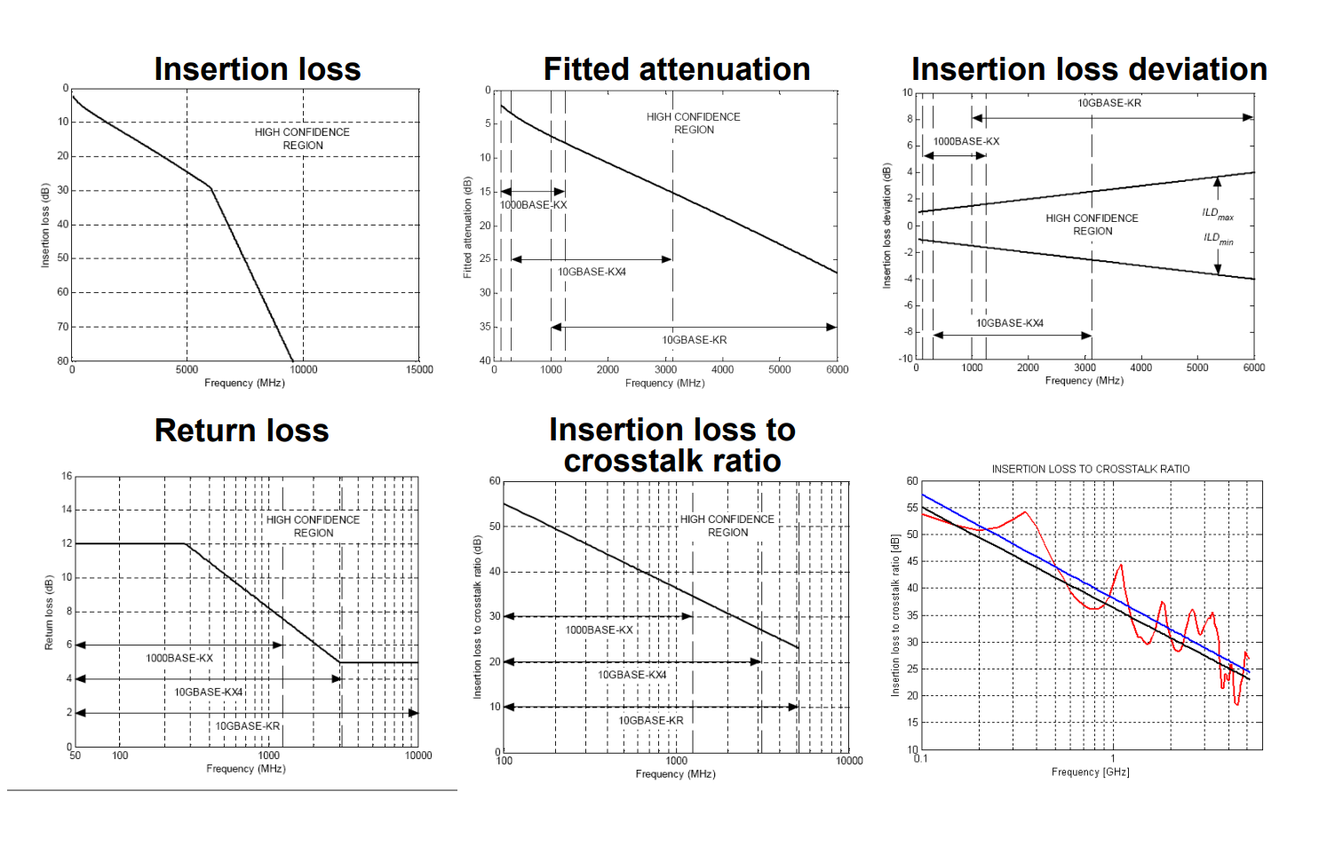
Frequency Domain Metrics – IEEE 10G Base KR
IL- Insertion Loss, RL- Return Loss, ILD-Insertion Loss Deviation,
FEXT – Far end crosstalk, NEXT –Near end crosstalk,
ICR – Insertion loss to crosstalk ratio
27

Slide 28
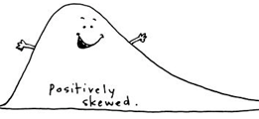
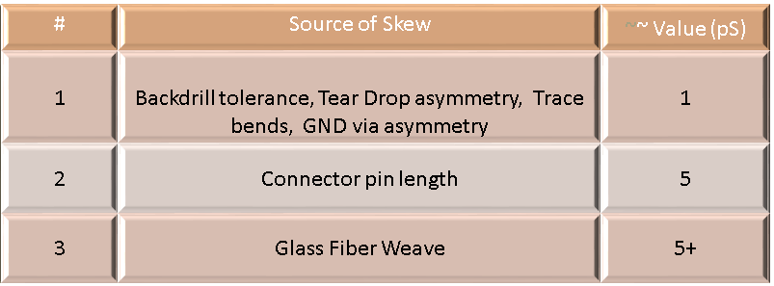
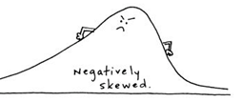
The Importance of Skew in Differential Signals

Slide 29
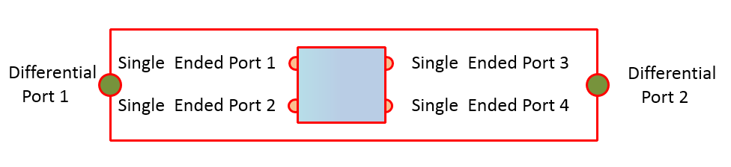

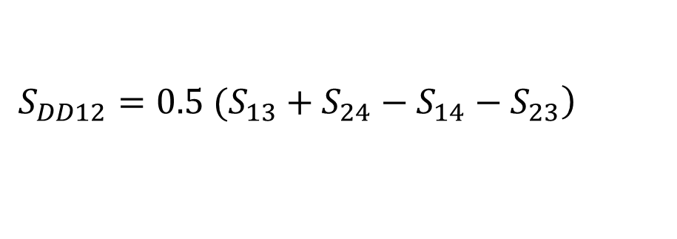
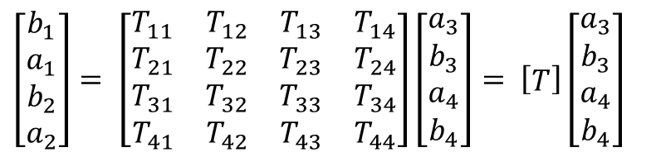
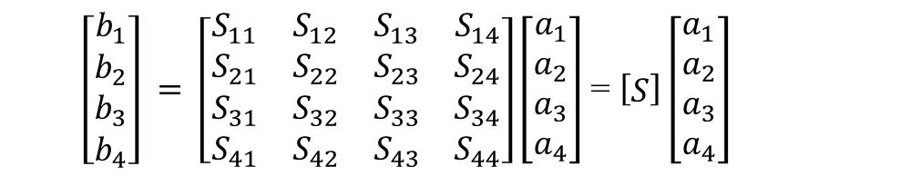
The Importance of Skew in Differential Signals
$\left[\begin{matrix}b_{1} \\ b_{2} \\ b_{3} \\ b_{4}\end{matrix}\right] = \left[\begin{matrix}S_{11} & S_{12} & S_{13} & S_{14} \\ S_{21} & S_{22} & S_{23} & S_{24} \\ S_{31} & S_{32} & S_{33} & S_{34} \\ S_{41} & S_{42} & S_{43} & S_{44}\end{matrix}\right]\left[\begin{matrix}a_{1} \\ a_{2} \\ a_{3} \\ a_{4}\end{matrix}\right]$ = $\left[\begin{matrix}S\end{matrix}\right]\left[\begin{matrix}a_{1} \\ a_{2} \\ a_{3} \\ a_{4}\end{matrix}\right]$
$$\left.S_{DD12}=0.5 (S_{13}+S_{24}−S_{14}−S_{23}\right)$$
$\left[\begin{matrix}b_{1} \\ a_{1} \\ b_{2} \\ a_{2}\end{matrix}\right]= \left[\begin{matrix}T_{11} & T_{12} & T_{13} & T_{14} \\ T_{21} & T_{22} & T_{23} & T_{24} \\ T_{31} & T_{32} & T_{33} & T_{34} \\ T_{41} & T_{42} & T_{43} & T_{44}\end{matrix}\right]\left[\begin{matrix}a_{3} \\ b_{3} \\ a_{4} \\ b_{4}\end{matrix}\right]= \left[\begin{matrix}T\end{matrix}\right]\left[\begin{matrix}a_{3} \\ b_{3} \\ a_{4} \\ b_{4}\end{matrix}\right]$
${[S]}_{A_cascade_B}=Convert_T_to_S {[T]}_{A}{[T]}_{B}$

Slide 30
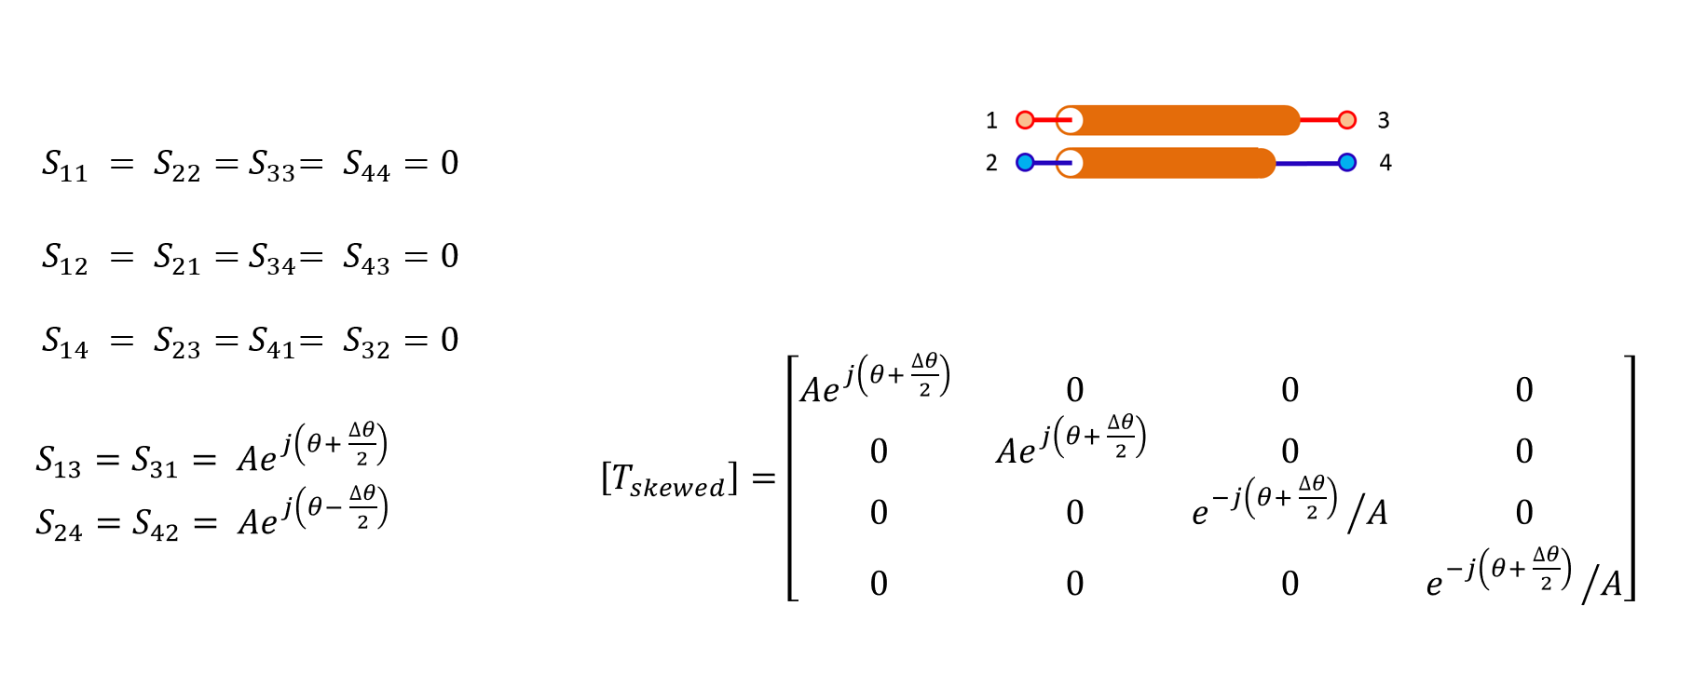
Two Uncoupled lines with skew

Slide 31
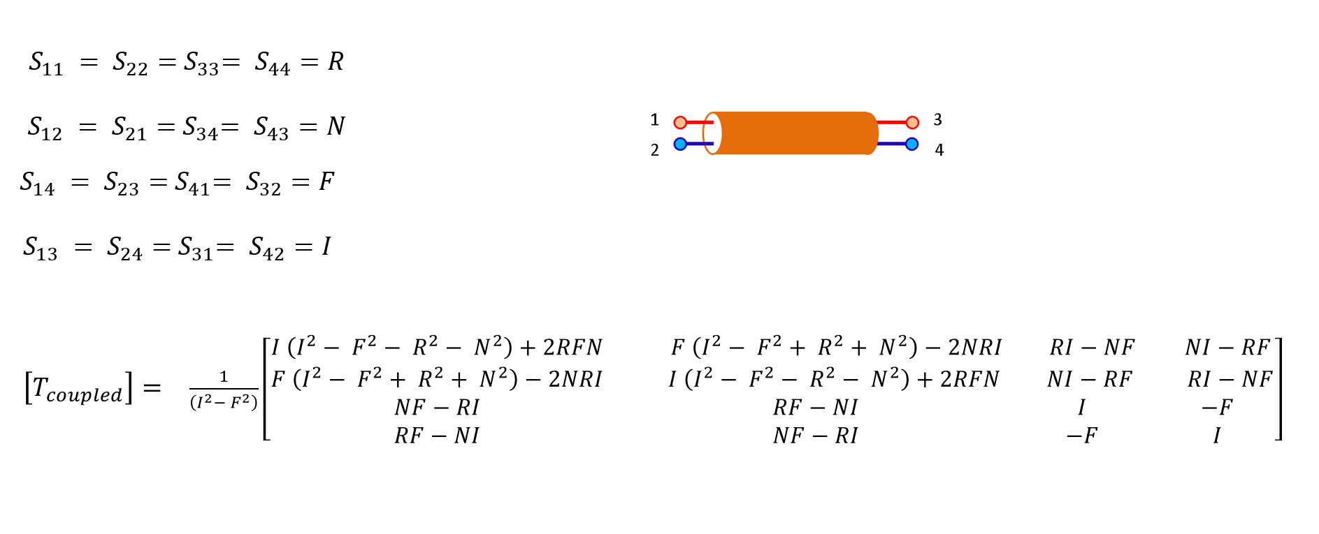
Coupled line without skew
31
31
9 of 23

Slide 32
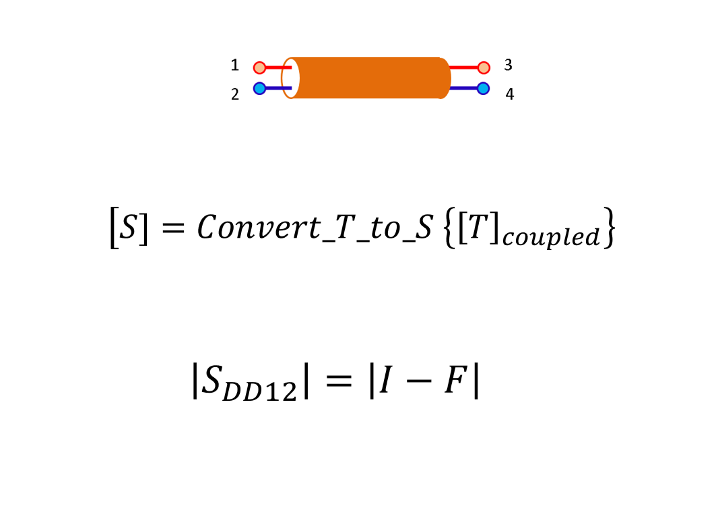
Coupled line without skew
32
32
9 of 23

Slide 33
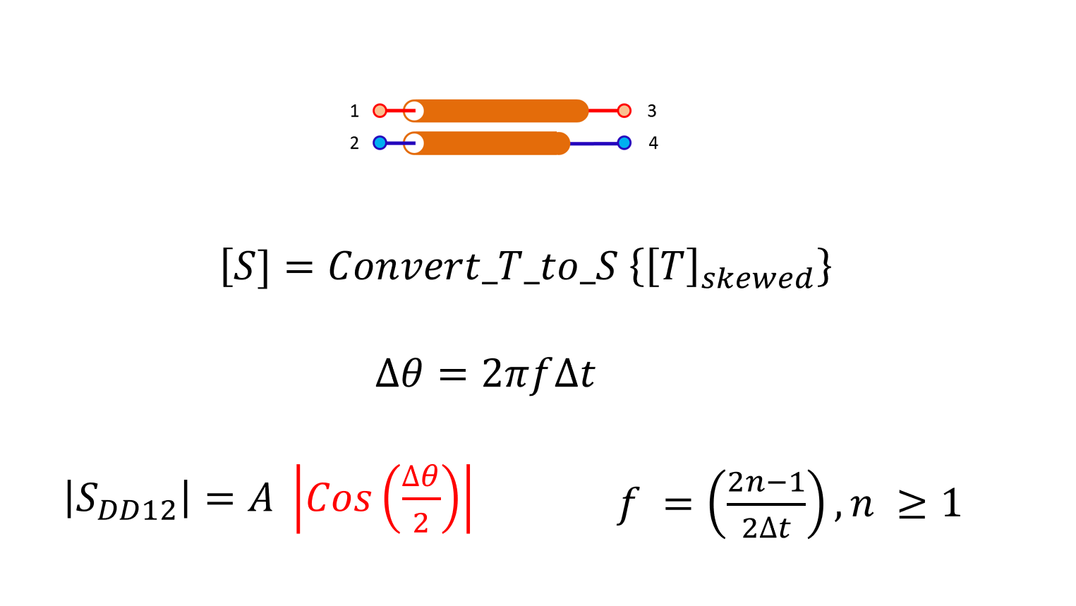
Un Coupled line with skew
33

Slide 34
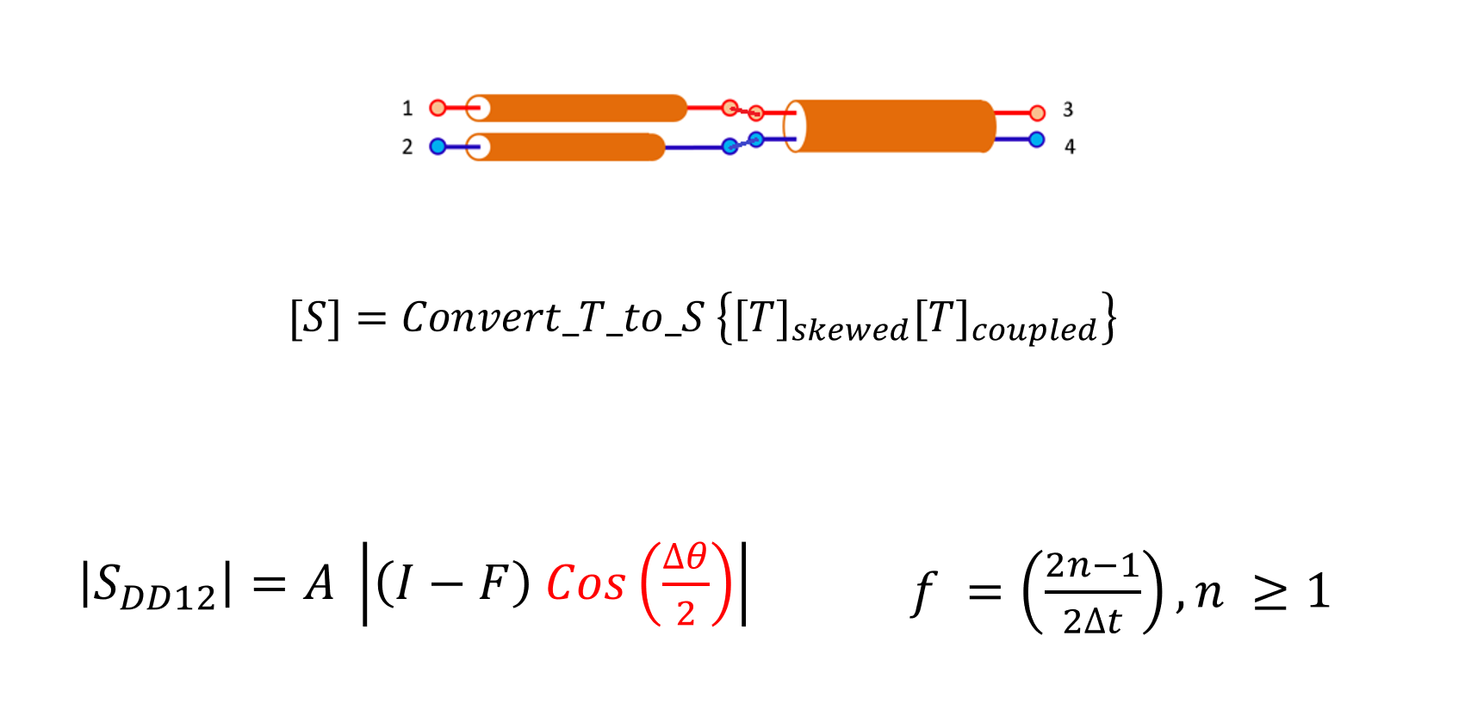
Coupled line with skew
34

Slide 35
Two Cascaded Coupled lines with skew
Increasing Far End Cross talk between P and N can help !
35

Slide 36
References
Fundamentals of Vector Network Analysis primer | Rohde & Schwarz (rohde-schwarz.com)
2. Accurate Test Fixture Characterization and De-embedding Deembedding Test Fixtures
For High-Speed Digital Applications
3. Deembedding Test Fixtures For High-Speed Digital Applications
4. Home Page | Signal Integrity Journal
(Search for Skew)
5. https://ieeexplore.ieee.org/search/searchresult.jsp?newsearch=true&queryText=Intra-Pair%20Skew
36

Slide 37
Module 6

