Slide 1
Introduction to Signal Integrity
please scan QR code for attendance

Slide 2
IEEE MTT-S
What is IEEE MTT-S?
The Microwave Theory and Techniques Technology Society (MTT-S) is an IEEE society that focuses on advancing the fields of microwave theory, techniques, and applications.
It serves as a global community for professionals in RF, microwave, millimeter-wave, and terahertz technologies.
Benefits of Joining MTT-S:
Access to Leading Publications: IEEE Transactions on Microwave Theory and Techniques, IEEE Microwave Magazine,…
Professional Development & Networking
Access to a global network of microwave professionals and experts.
Mentorship opportunities and technical conferences, including IMS (International Microwave Symposium).
Educational Resources
Exclusive webinars, tutorials, and workshops.
Special interest groups for students, young professionals, and women in microwaves.
Discounts on Conferences & Workshops
Reduced rates for IEEE-sponsored conferences, courses, workshops, and symposiums such as IMS.
Career Advancement
Leadership opportunities within the society.
Recognition through awards and scholarships.
Get Involved! Learn more about MTT-S membership at: MTT-S Website

Slide 3
Introduction to Signal Integrity

Slide 4
Outline
Module 1: Overview on Ansys Electronics Portfolio
Module 2: Simulating Microstrip Line / Stripline / Differential Pair
Module 3: Differential Via Modeling
Module 4: Signal Skew Compensation for High-Speed Differential Transmission Line
Module 5: TDR Analysis
Module 6: Ansys Solution Workflow for Layout Assembly (Package on Board Example)

Slide 5
Module 1
Overview on Ansys Electronics Portfolio

Slide 6
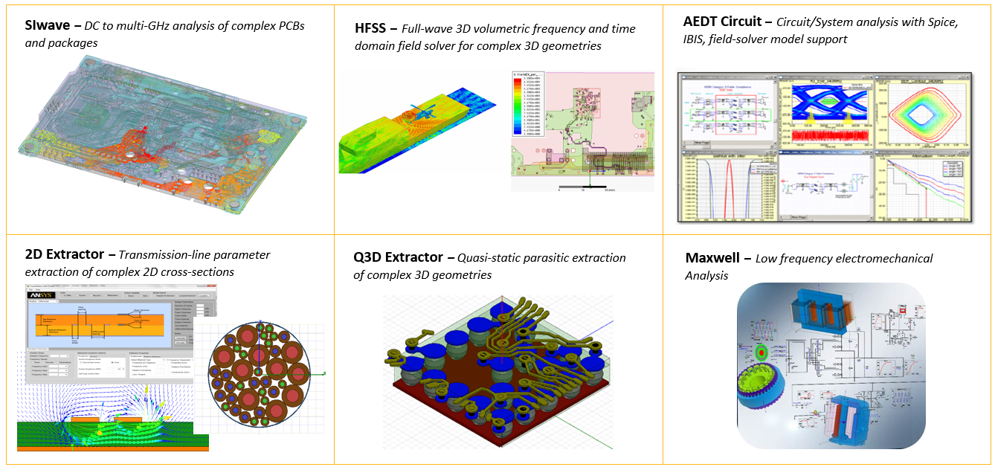
Ansys Electromagnetics Overview

Slide 7
Ansys SIWave

Slide 8
Key Application Areas

Slide 9
Two GUI Environments

Slide 10
Supported ECAD Translations

Slide 11
Ansys HFSS

Slide 12
HFSS in ANSYS Electronics Desktop (AEDT)

Slide 13
HFSS (MCAD) & 3D Layout (ECAD)

Slide 14
Module 2
Transmission Line & Transitioning Modeling
Simulating Microstrip Line / Stripline / Differential Pair

Slide 15
Transmission Lines

Slide 16
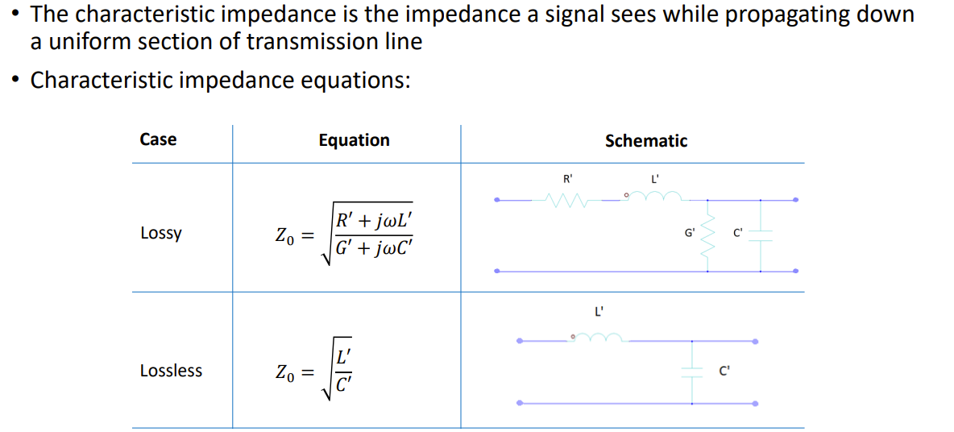
Characteristic Impedance of a Transmission Line

Slide 17
HFSS in ANSYS Electronics Desktop (AEDT)

Slide 18
Demo Examples: * Simple Microstrip Line * Differential Stripline

Slide 19
Module 3
Differential Via Modeling

Slide 20
HFSS (MCAD) & 3D Layout (ECAD)

Slide 21
HFSS (MCAD) & 3D Layout (ECAD)

Slide 22
HFSS (MCAD) & 3D Layout (ECAD)

Slide 23
HFSS (MCAD) & 3D Layout (ECAD)

Slide 24
Module 5
TDR Analysis

Slide 25
TDR Analysis

Slide 26
TDR - Reflections

Slide 27
TDR – Reflections – Numerical Example

Slide 28
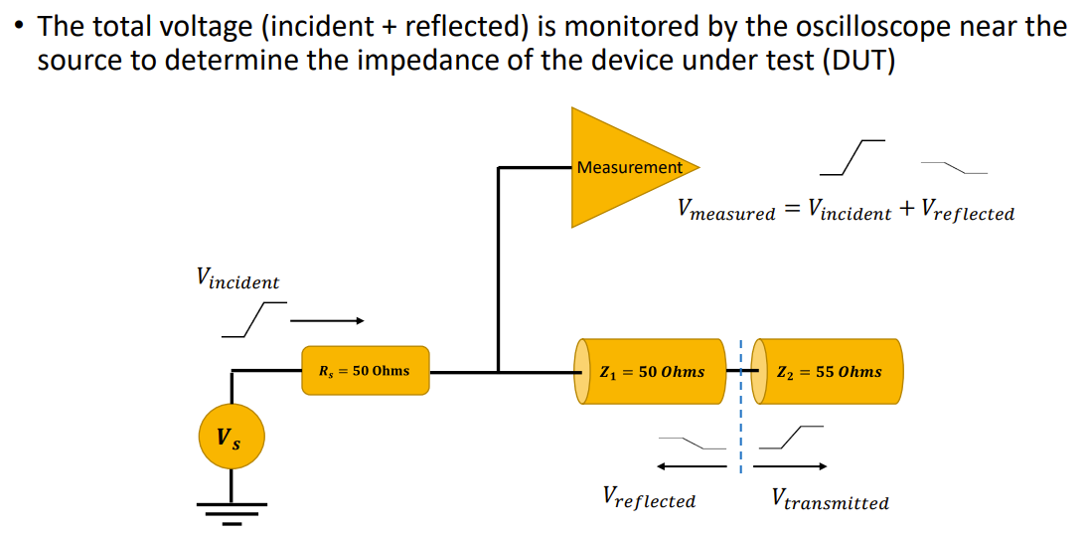
TDR – Voltage Measurement

Slide 29
TDR – Determining the Unknown Impedance

Slide 30
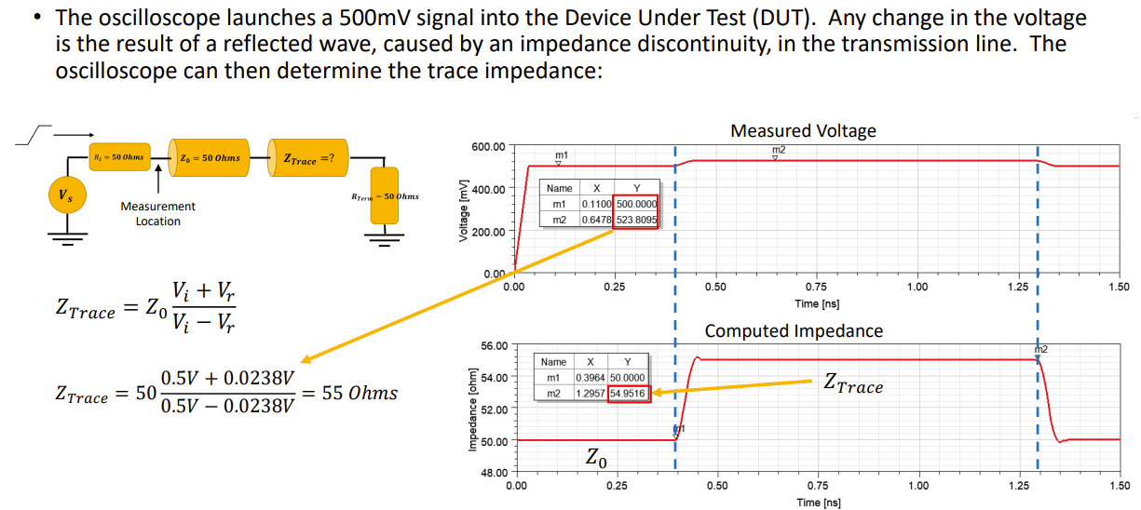
TDR – Example Computation

Slide 31
TDR - Reflections

Slide 32
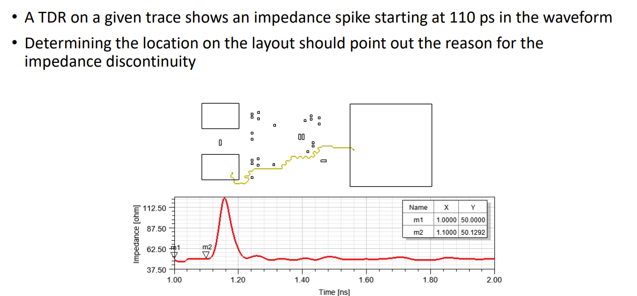
Estimating the Location of an Impedance Discontinuity

Slide 33
Estimating the Location of an Impedance Discontinuity

Slide 34
Estimating the Location of an Impedance Discontinuity

Slide 35
Bandwidth of a Signal

Slide 36
Bandwidth of a Signal

Slide 37
Inductor and Capacitor Effect

Slide 38
The Effect of the Rise Time

Slide 39
The Effect of the Rise Time

Slide 40
HFSS (MCAD) & 3D Layout (ECAD)

Slide 41
HFSS (MCAD) & 3D Layout (ECAD)

Slide 42
HFSS (MCAD) & 3D Layout (ECAD)

Slide 43
HFSS (MCAD) & 3D Layout (ECAD)

Slide 44
HFSS (MCAD) & 3D Layout (ECAD)

Slide 45
HFSS (MCAD) & 3D Layout (ECAD)

