Slide 1
IEEE MTT-S
What is IEEE MTT-S?
The Microwave Theory and Techniques Technology Society (MTT-S) is an IEEE society that focuses on advancing the fields of microwave theory, techniques, and applications.
It serves as a global community for professionals in RF, microwave, millimeter-wave, and terahertz technologies.
Benefits of Joining MTT-S:
Access to Leading Publications: IEEE Transactions on Microwave Theory and Techniques, IEEE Microwave Magazine,…
Professional Development & Networking
  Access to a global network of microwave professionals and experts.
  Mentorship opportunities and technical conferences, including IMS (International Microwave Symposium).
Educational Resources
  Exclusive webinars, tutorials, and workshops.
  Special interest groups for students, young professionals, and women in microwaves.
Discounts on Conferences & Workshops
  Reduced rates for IEEE-sponsored conferences, courses, workshops, and symposiums such as IMS.
Career Advancement
  Leadership opportunities within the society.
  Recognition through awards and scholarships.
Get Involved! Learn more about MTT-S membership at: MTT-S Website

Slide 2

Introduction to Signal Integrity

Slide 3
Main points:
Frequency domain is powerful.
Time domain is powerful.
Combining the two domains = 2X powerful.

Slide 4
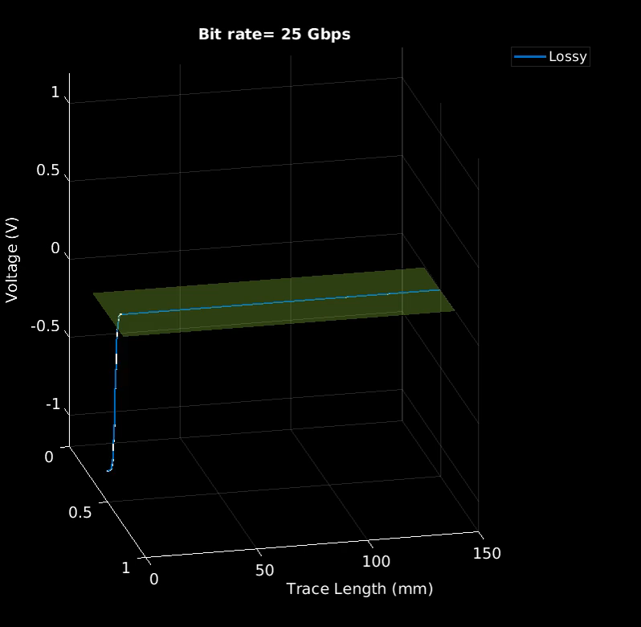
Propagation in Interconnects
Losses, no reflections.
ISI increases with data rate.

Slide 5
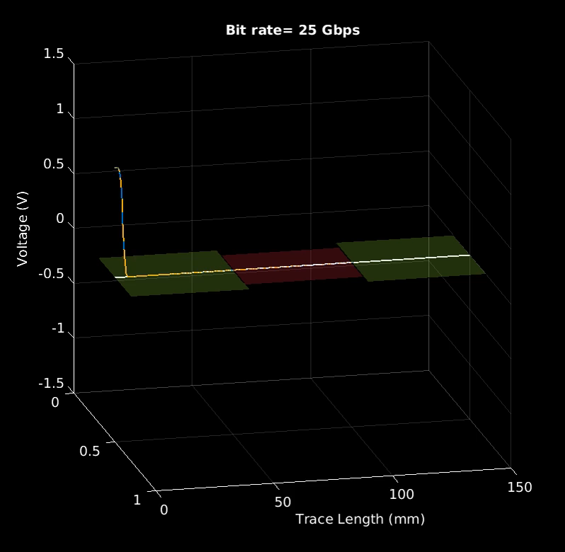
Propagation in Interconnects
Reflections.
What happens when transit from low to high impedance?

Slide 6

Propagation in Interconnects
Reflections.
What happens when transit from low to high impedance?

Slide 7
2X Automatic Fixture Removal
Determine 1X from 2X.
Use 1X to de-embed the fixture.
Leverage Time and Frequency representations!
1X
2X
DUT

Slide 8
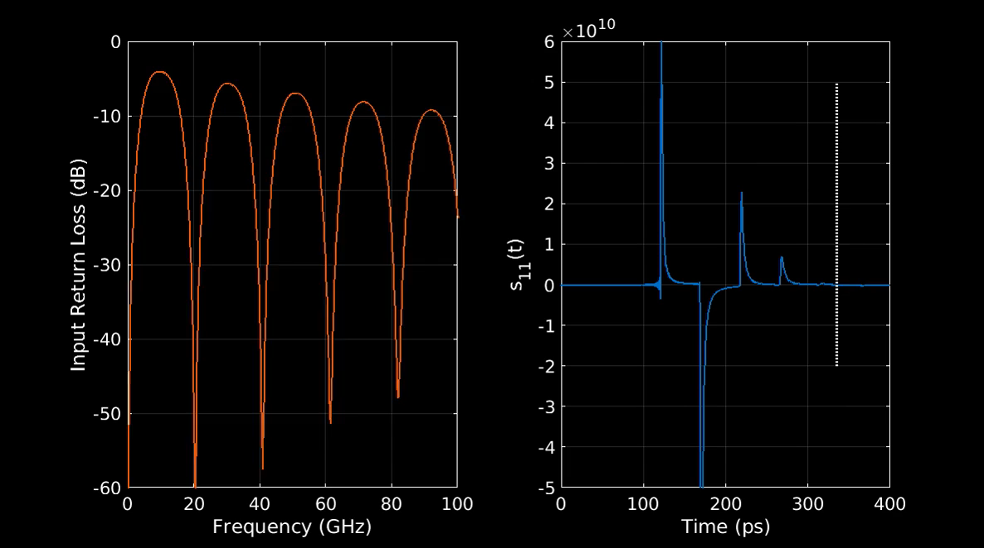
Note 1: S11 in the time domain does not change!

Slide 9
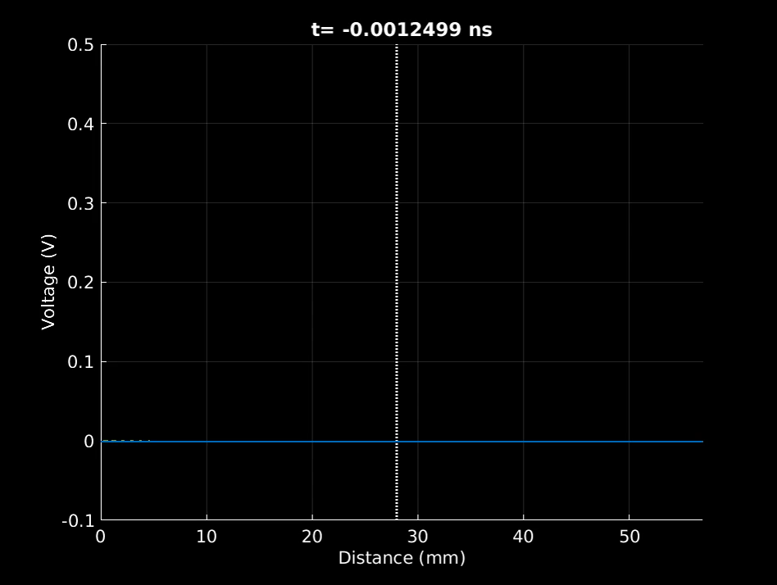
Note 2: Delay is the same as S11 length!

Slide 10
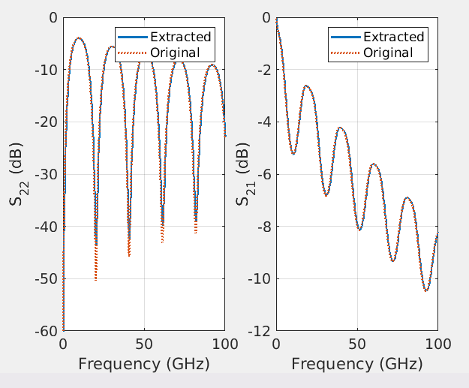
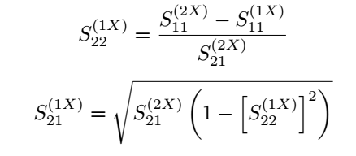
Automatic Fixture Removal
Calculate S11 from time domain.
Use below equations to calculate other parameters

Slide 11
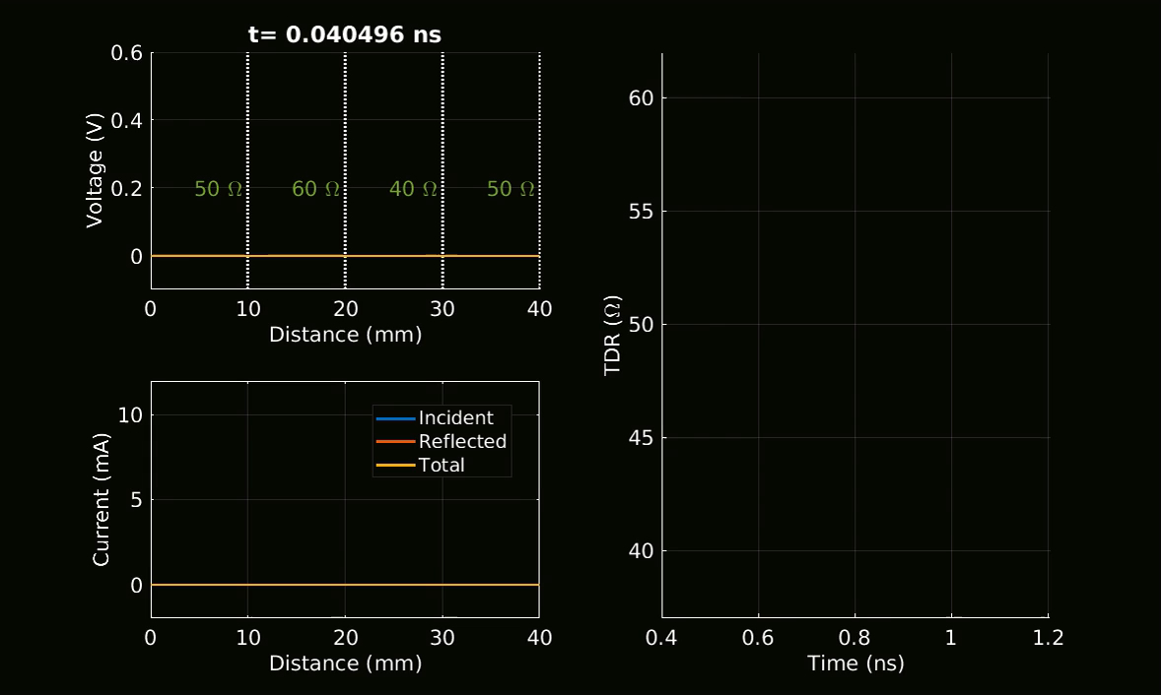
TDR

